Slide 1


Power Platform
The Game Changer
Power Apps
Power BI
Microsoft Flow
Cortana
SQL Server
Hiram Fleitas
Fleitas Arts
github.com/hfleitas/gamechanger
Notes:
Image ref: https://img-prod-cms-rt-microsoft-com.akamaized.net/cms/api/am/imageFileData/RE2x0JM?ver=a32f&q=90&m=6&h=600&w=1600&b=%23FFFFFFFF&l=f&o=t&aim=true

Slide 2


Please silence cell phones

Slide 3


Slide 4

Notes:
Image ref: https://pwrappscdn.azureedge.net/cvt-3376f88ecf77a2ae14e64ea4f8a4ee7cd52d6cc1c364c0822c99b4a310a31c00/images/page/cds-apps/hero/hero_1259x472.jpg

Slide 5
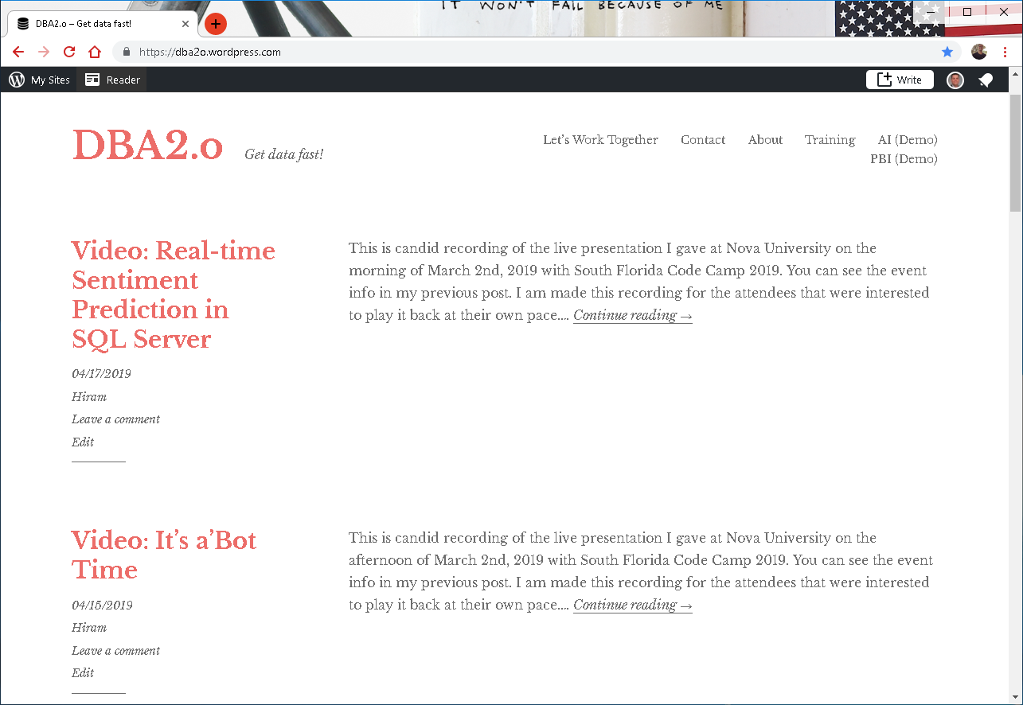

Slide 6
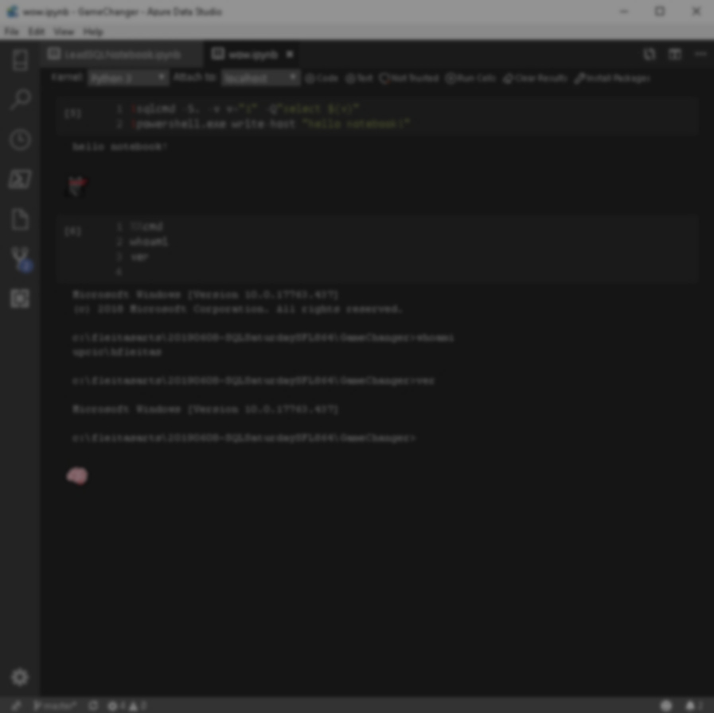
Session evaluations
This is the link:
bit.ly/2GPsPMr
Your feedback is very important.
Submit your feedback by the end of this presentation.

Slide 7











Hiram Fleitas
Owner Fleitas Arts
Bio
Father
Principal DB Architect
Power BI since 2016
Developer since 1995
SQL Server since 1999
USCG Auxiliary Flotilla Staff Officer
@hiramfleitas
/hfleitas
hiram@fleitasarts.com
hiramfletias
fleitasarts.com

Slide 8

Agenda
Intro
Azure Data Studio Notebook
PowerApps
Microsoft Flow
Data Gateway
Cortana - Power BI
Security
Resources

Slide 9


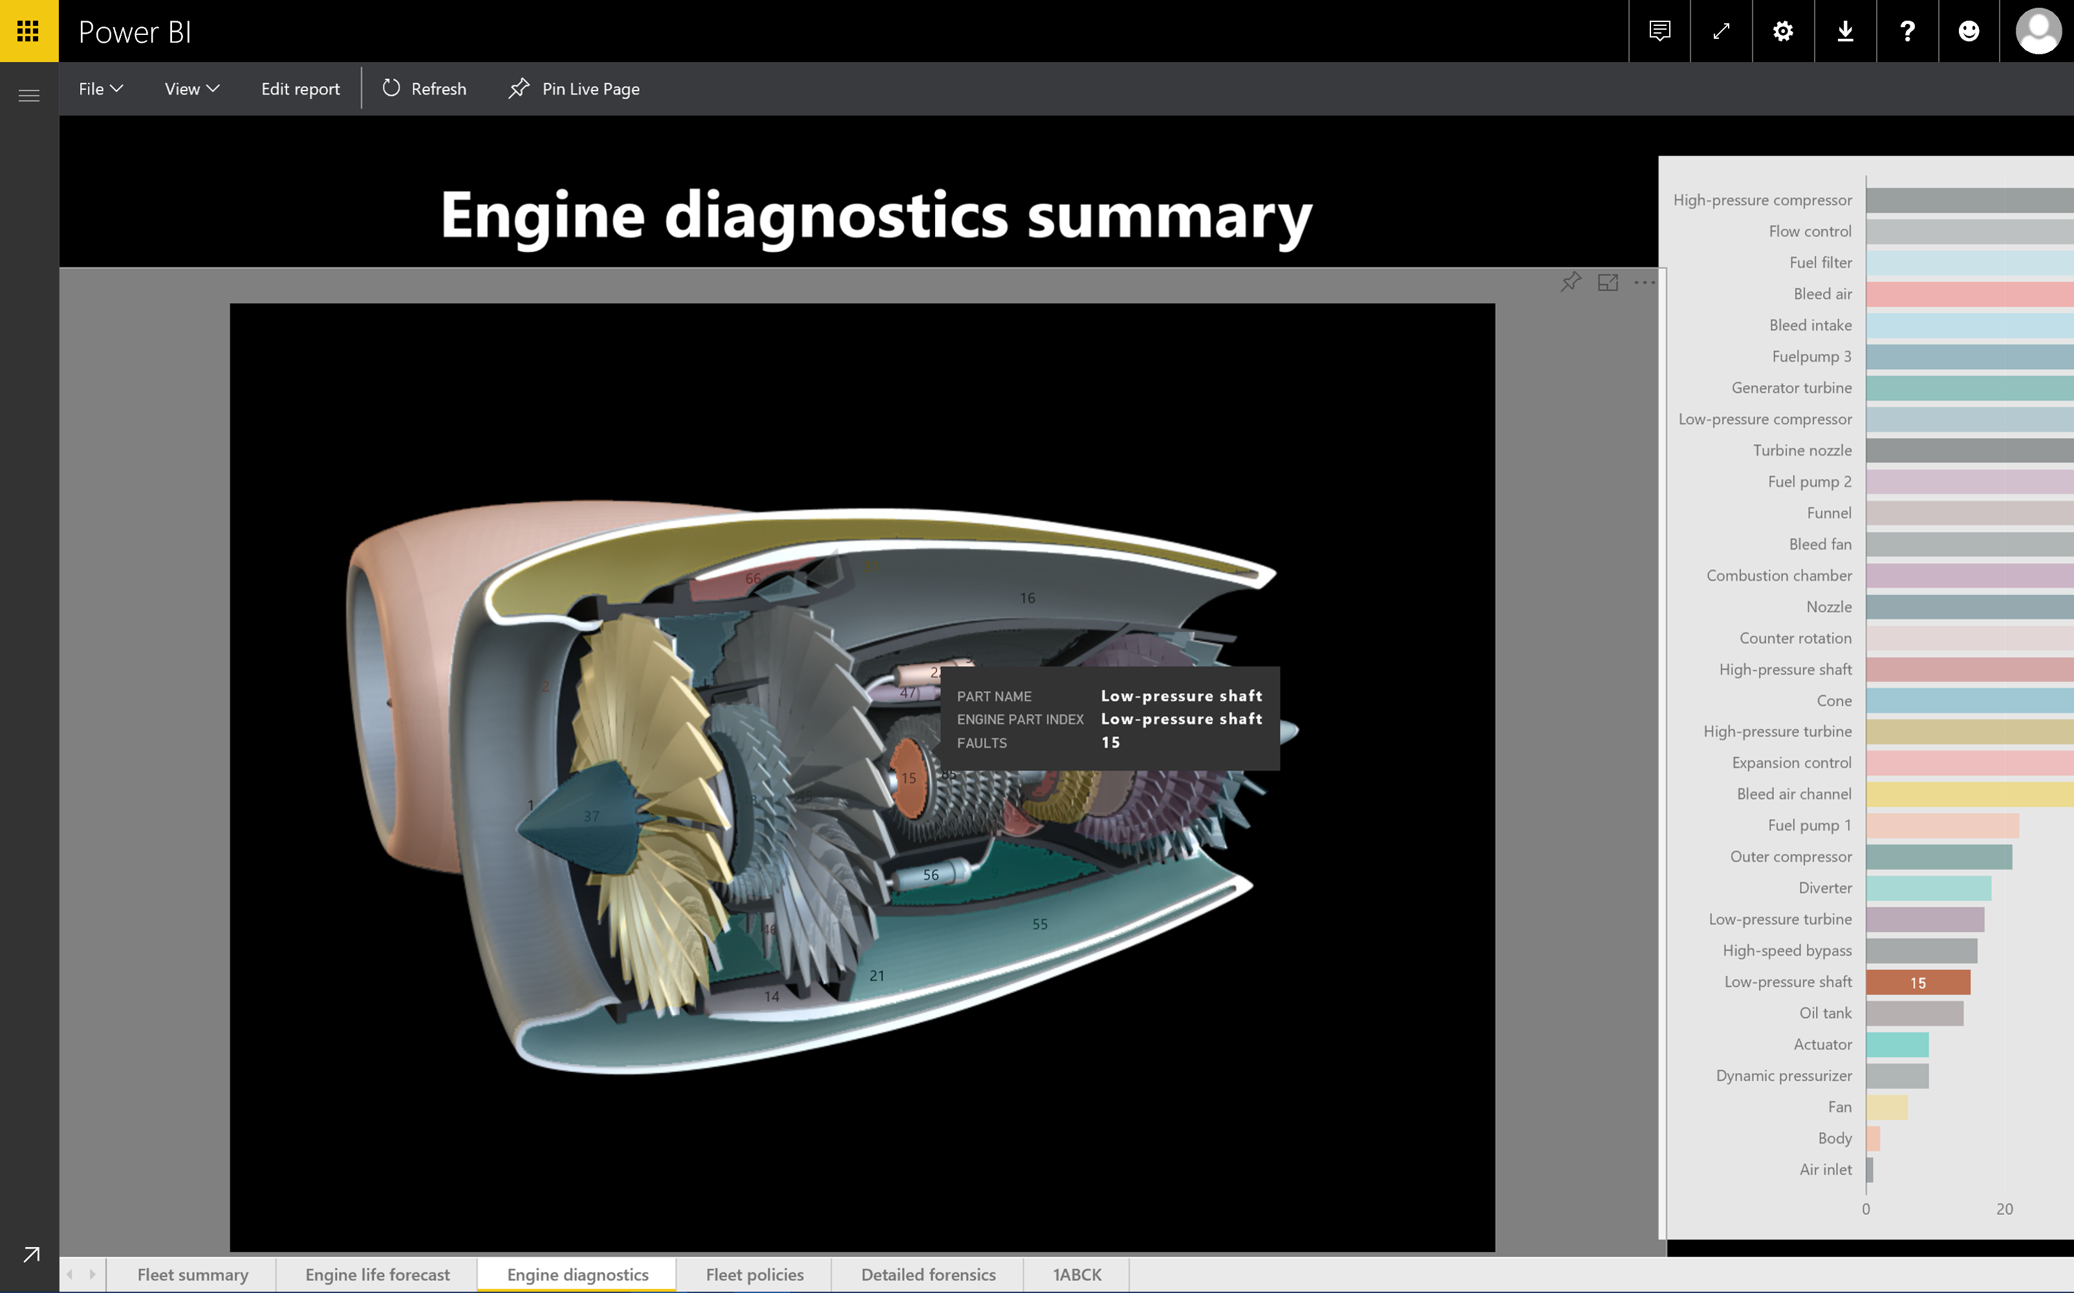
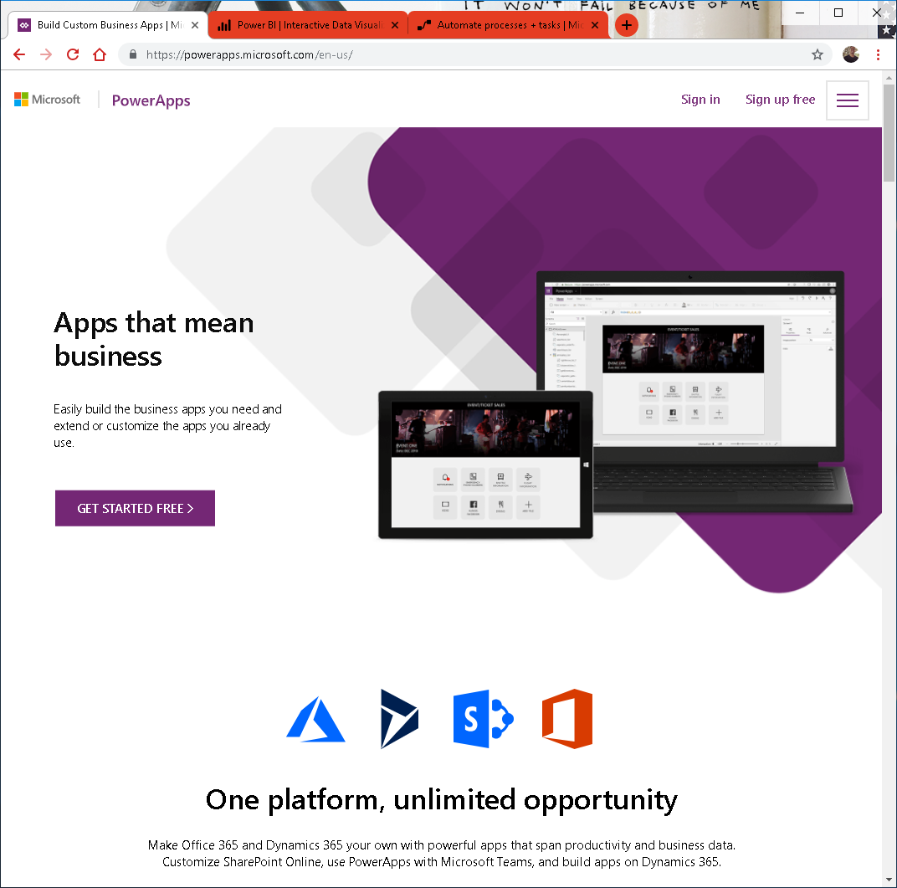
Intro

Slide 10

Build apps without limits
Use a variety of development and application lifecycle management tools to meet your needs—whether simple or complex. Pro developers can use the Common Data Service for Apps software development kit (SDK) and code plugins to build apps and create customizations using familiar tools like Visual Studio.

Slide 11
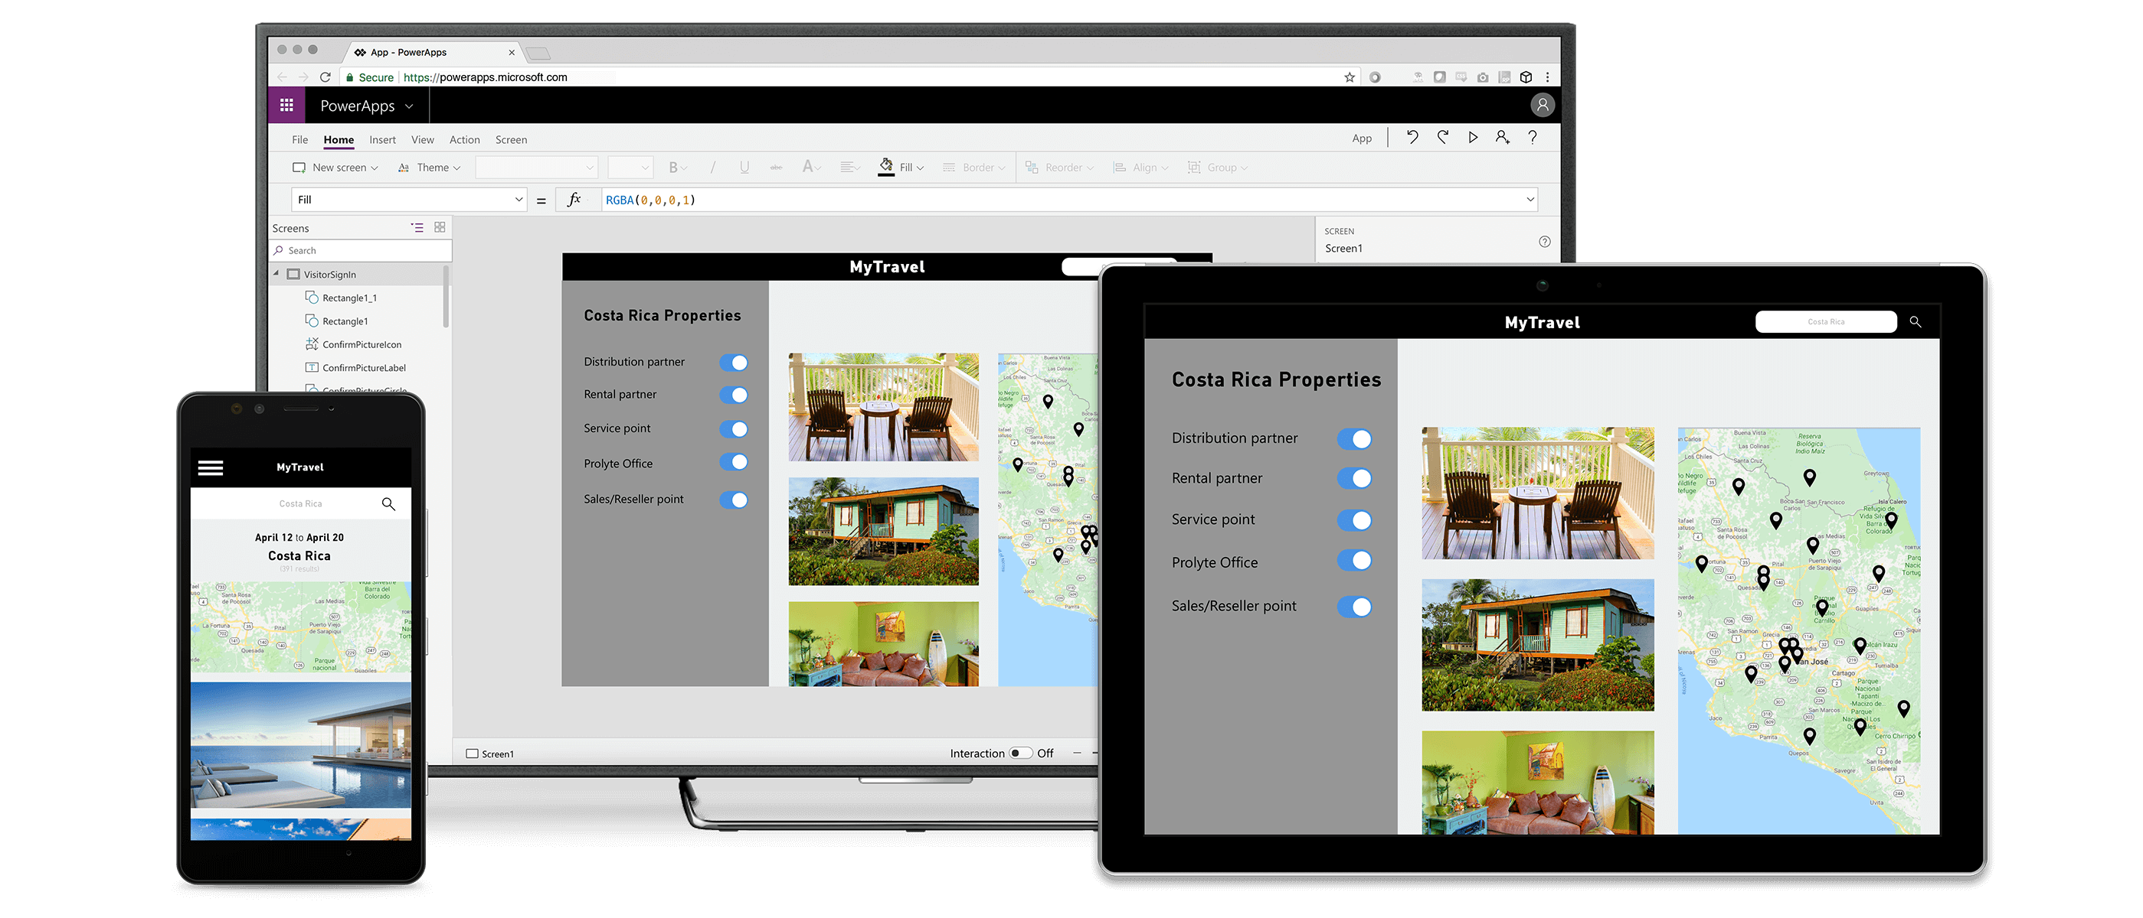
Innovate faster
Build apps fast with a point-and-click approach to app design. Choose from a large selection of templates or start from a blank canvas. Easily connect your app to data and use Excel-like expressions to easily add logic. Publish your app to the web, iOS, Android, and Windows 10. It’s that easy.

Slide 12
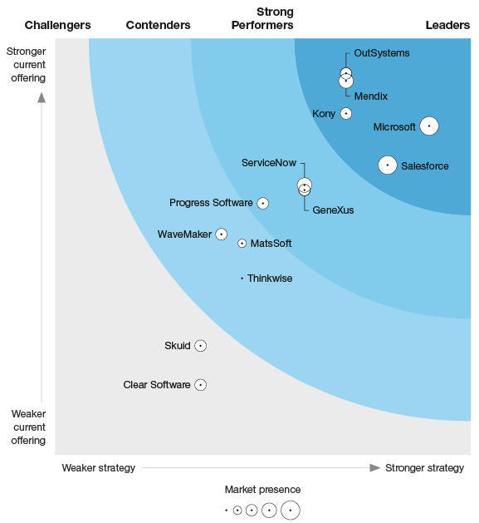

Q1 2019
Named Microsoft as a leader in
The Forrester Wave™: Low-Code Development Platforms For AD&D Professionals
READ REPORT >
The Forrester Wave™ is copyrighted by Forrester Research, Inc. Forrester and Forrester Wave™ are trademarks of Forrester Research, Inc. The Forrester Wave™ is a graphical representation of Forrester's call on a market and is plotted using a detailed spreadsheet with exposed scores, weightings, and comments. Forrester does not endorse any vendor, product, or service depicted in the Forrester Wave™. Information is based on best available resources. Opinions reflect judgment at the time and are subject to change.

Slide 13


July 2018
Named Microsoft again as a Leader in the Magic Quadrant for Mobile App Development Platforms
READ REPORT >
This graphic was published by Gartner, Inc. as part of a larger research document and should be evaluated in the context of the entire document. The Gartner document is available upon request from Microsoft. Gartner does not endorse any vendor, product or service depicted in its research publications, and does not advise technology users to select only those vendors with the highest ratings or other designation. Gartner research publications consist of the opinions of Gartner's research organization and should not be construed as statements of fact. Gartner disclaims all warranties, expressed or implied, with respect to this research, including any warranties of merchantability or fitness for a particular purpose.
Notes:
Microsoft
Microsoft is again a Leader. Xamarin, which Microsoft acquired in 2016, remains a staple of the professional development capabilities of Microsoft's MADP, while the customer base for its PowerApps high-productivity tool is growing. A very large number of enterprise customers use PowerApps, and use of Xamarin has increased significantly since Microsoft acquired it.
Microsoft's platform includes professional development tools that feature Xamarin in Visual Studio. Visual Studio App Center has become the centerpiece of Microsoft's mobile app life cycle development support. For its back-end services, Microsoft continues to expand the capabilities of Azure, which is a true PaaS with mobile-specific functionality as just one of its components. For citizen developers, Microsoft continues to improve PowerApps and Microsoft Flow, although there is, as yet, no connection or bidirectional collaboration between these high-productivity tools and the professional development options (except for Azure Functions and services).
Strengths
*Overall viability: Since acquiring Xamarin in 2016, enterprises' interest in Microsoft as a MADP vendor has increased drastically. Having lost the consumer mobile OS battle to Google (with Android) and Apple (with iOS), Microsoft is investing heavily in development tools for mobile apps (and more) to ensure its relevance to developers. Reference customers expressed above-average overall satisfaction with Microsoft's MADP, in comparison to those of other vendors in this Magic Quadrant.
*Innovation: Microsoft continues to invest in Azure back-end services that support mobile and multiexperience development. It also continues to invest in tools for multiple developer personas, including professional and citizen developers. Additionally, it continues to increase its support for emerging technologies through the Windows Mixed Reality platform and Azure Bot Service.
*Market understanding: Microsoft understands that professional developers continually need new tools for multiexperience development and DevOps practices. Microsoft fulfills these needs by delivering a best-of-breed IDE (Visual Studio) and its open-source Visual Studio Code editor, while offering integrated DevOps support through Visual Studio App Center.
Cautions
*Sales execution and pricing: Microsoft's licensing models can be complex. The Microsoft MADP comprises many different tools that are often licensed differently, based on numbers of users and transactions. This makes it difficult to estimate ongoing development costs.
*High-productivity app development tool: Although Microsoft offers a high-productivity development tool (PowerApps), it lacks tight integration with its own professional developer tools. The components shared by the tools are primarily Azure Functions, Logic Apps and Azure API Management, and the tool roadmaps are managed by separate Microsoft product organizations.
*Marketing execution: Microsoft's MADP offering comprises many tools and services under the Visual Studio, Azure and PowerApps brandings, which causes some confusion in the market. The practice of assigning separate brand names (PowerApps and Visual Studio, for example, are completely distinct names) undermines its marketing of a single MADP.
OutSystems
OutSystems is again a Leader. It markets a high-productivity development platform with which to rapidly build a unified user experience across mobile, web, SMS, email, chat and voice service touchpoints. A very large number of organizations use the free edition of OutSystems' product. A smaller number (approximately 1,100) are paying customers, with many of these being SMBs.
The OutSystems platform uses a visual-modeling language to create app UI, logic, data synchronization (for offline use) and integration with its back-end system. Customers can extend its visual models using Cascading Style Sheets (CSS) and JavaScript for the UI; Objective-C, Swift and Java for the native capabilities; and C#, Java and SQL for the back-end capabilities. OutSystems' proprietary Silk UI framework is used across the platform for development of apps for the web, tablets and mobile phones using a hybrid approach that also uses HTML5 and Apache Cordova. OutSystems offers core mobile services and SDKs for third-party tools for each back-end API, with complete models and documentation of API entities.
Strengths
*Product offering: In addition to mobile apps, over 90% of OutSystems' customers use its platform to create mobile websites or portals (B2C, B2B or B2E). Correspondingly, reference customers identified its MADP as easy to use, with a short learning curve. All user interactions are automatically registered, with identification of user, app, screen/step and actions performed by a user, to promote continuous improvement of the user experience.
*Innovation: OutSystems recently launched an AI-assisted analysis tool to help customers monitor the impact of app development on their overall business strategy by delivering insight into what are the truly impactful initiatives. This helps OutSystems evolve its platform to support new approaches that will drive automation and make insights more accessible as apps become more widely adopted.
*Customer experience: Reference customers expressed above-average overall satisfaction with OutSystems' MADP, in comparison to those of other vendors in this Magic Quadrant. OutSystems' reference customers praised the platform's ease of use, which is achieved through the availability of prebuilt objects and widgets, and the ability to rapidly build and deploy apps in low- or zero-code environments.
Cautions
*Pricing: Some reference customers expressed concerns about OutSystems' licensing. They reported, for example, that the licensing scheme is initially hard to understand and that the practice of licensing by application objects requires tight management when architecting a solution.
*Professional developer enablement tool: Although OutSystems received above-average scores for its professional developer tools, some reference customers pointed to missing deployment features, such as the ability to generate app-native code for different versions and platforms. They also expressed a desire for .ipa and .apk binary generation not to be dependent on an external OutSystems cloud service.
*Geographic strategy: Although OutSystems has an established network of reseller and delivery partners, some reference customers indicated that more service provider partners are needed, as the lack of options in some regions had left them with inflexible and inefficient delivery partners.

Slide 14
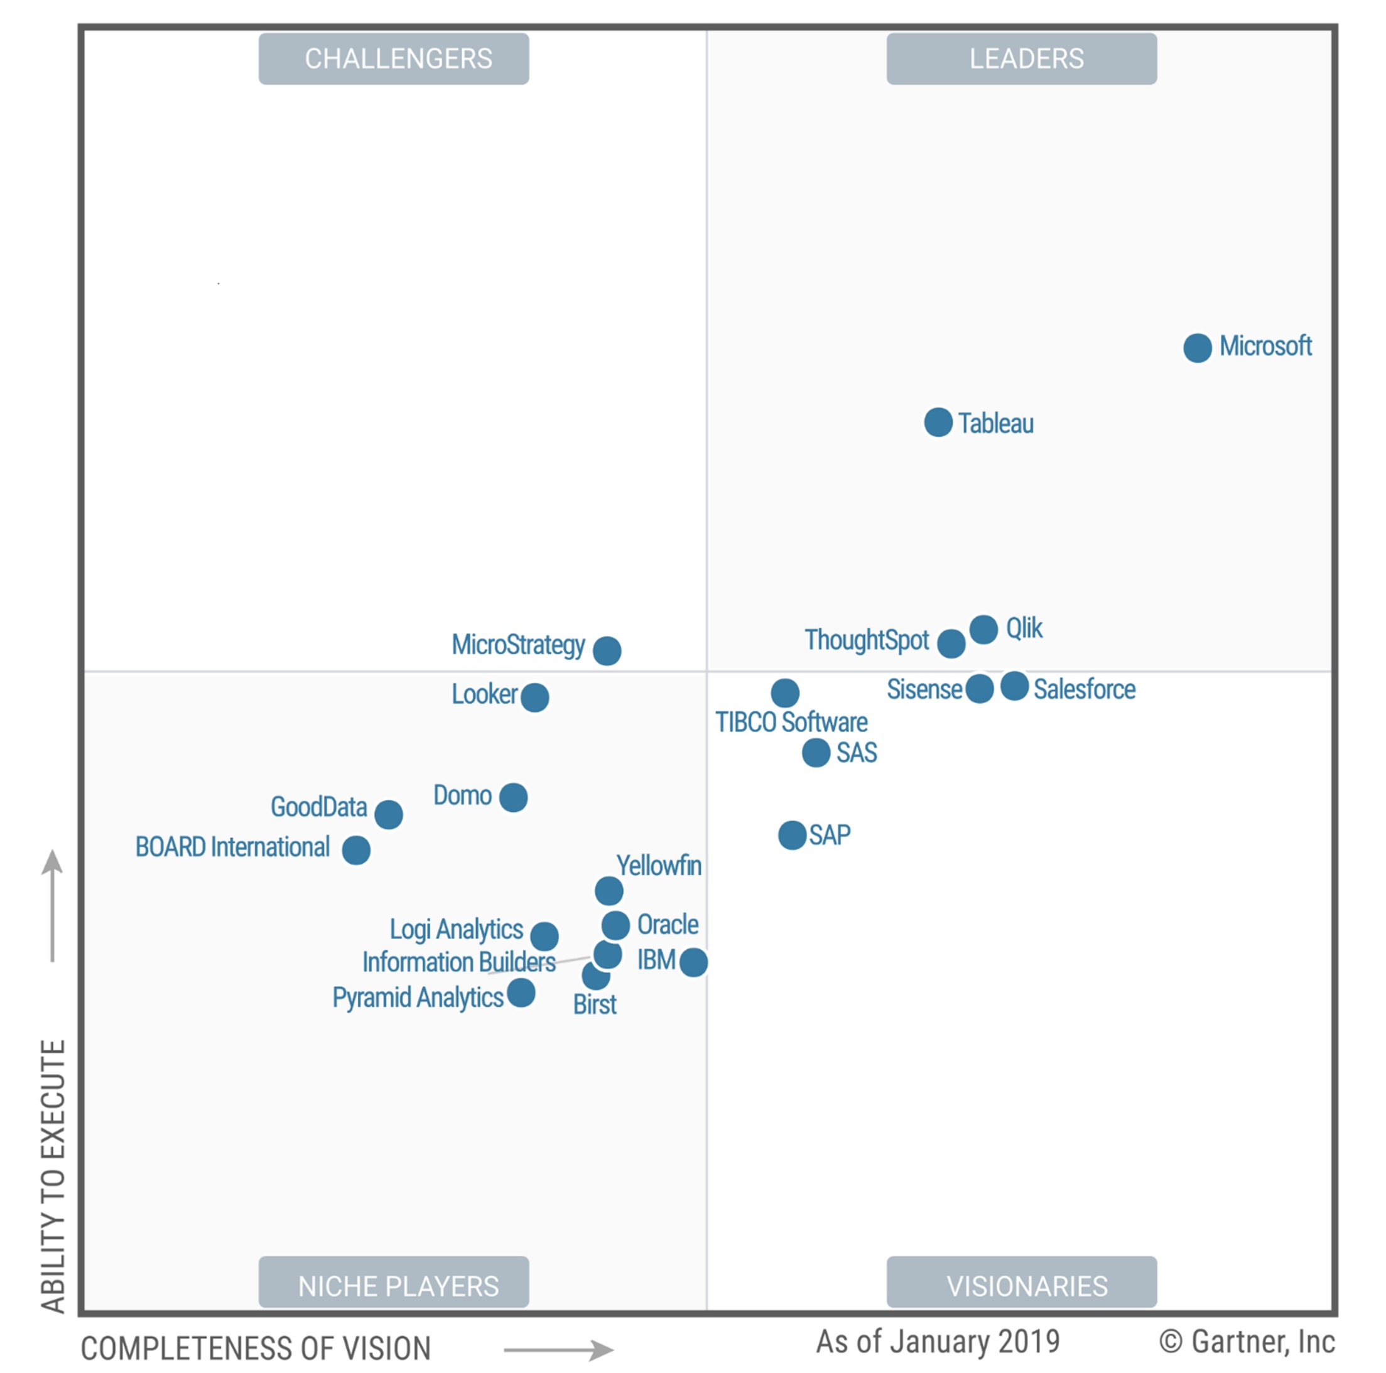
February 2019
Recognized as a leader for Analytics and Business Intelligence Platforms–for 12 consecutive years
READ REPORT >
This graphic was published by Gartner, Inc. as part of a larger research document and should be evaluated in the context of the entire document. The Gartner document is available upon request from Microsoft.
Gartner does not endorse any vendor, product or service depicted in its research publications, and does not advise technology users to select only those vendors with the highest ratings or other designation. Gartner research publications consist of the opinions of Gartner’s research organization and should not be construed as statements of fact. Gartner disclaims all warranties, expressed or implied, with respect to this research, including any warranties of merchantability or fitness for a particular purpose.
Notes:
Power BI Desktop updates monthly and the service itself weekly. With this it even looks to separate itself from the pack even more as increased amount of features come around and presented by the community.

Slide 15
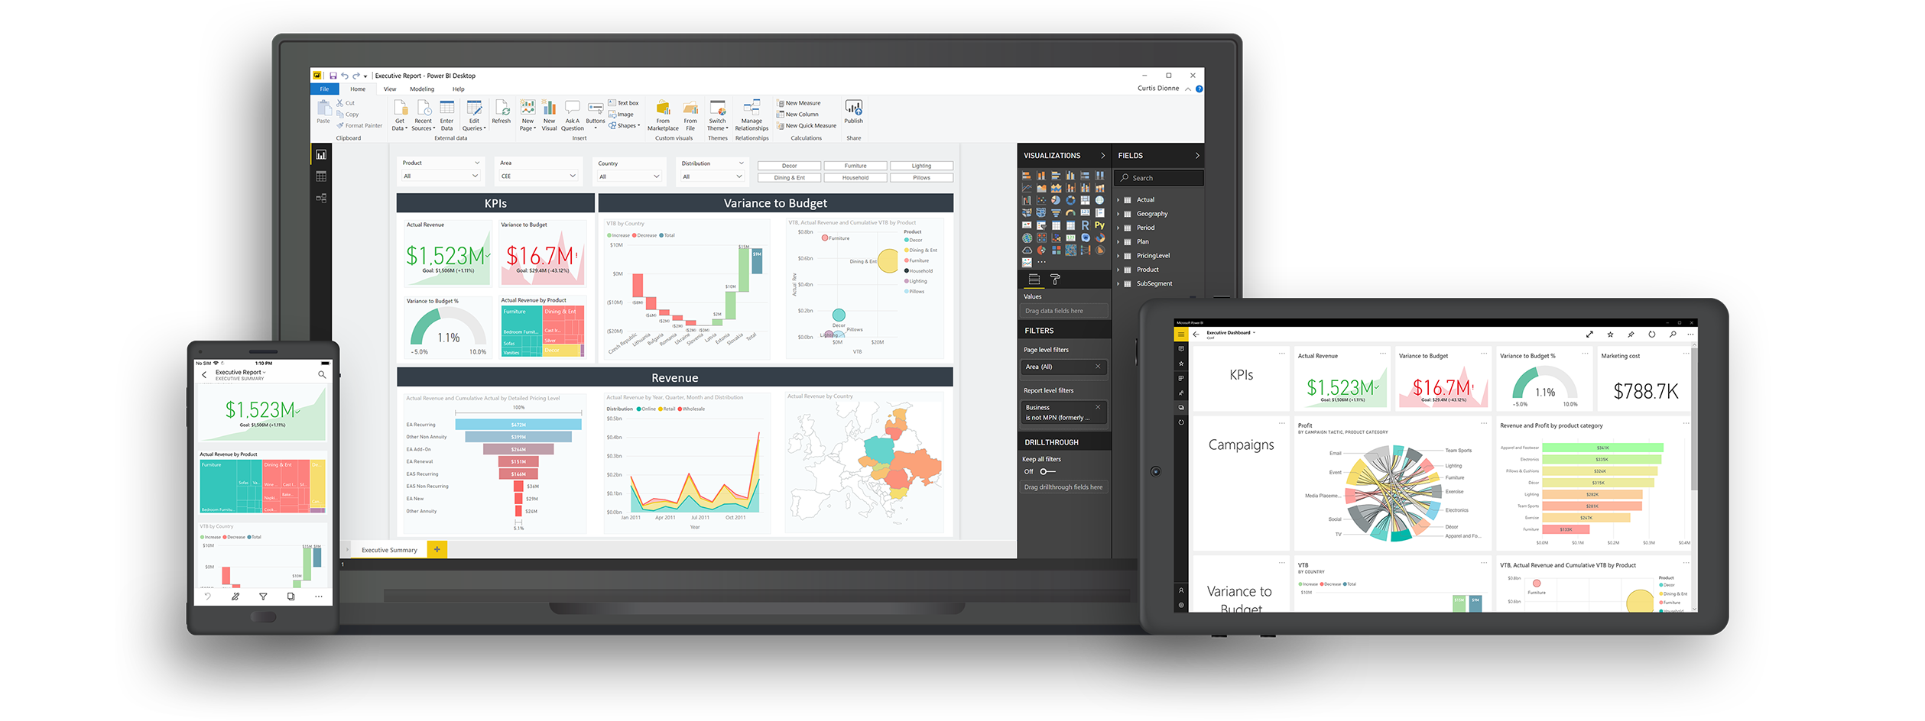
Fastest Growing BI Vendor
5 Million +
users
200,000
organizations
200+
countries
Notes:
Power BI

Slide 16


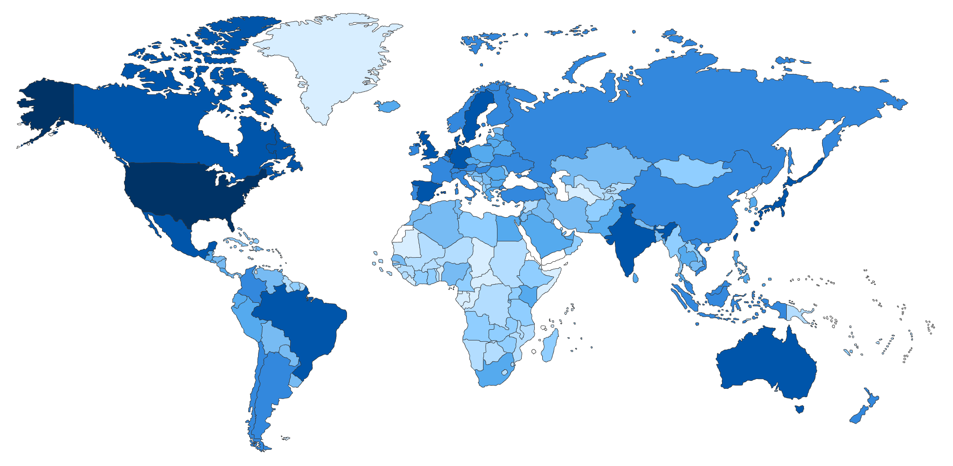








Global Scale and Enterprise Readiness
18,000 Cities globally access the service daily
190 Countries & territories
43 Languages
Global coverage
19 datacenters worldwide
National Clouds
US Government
China
Germany
Shaded areas show countries with Power BI usage. The darker the color the greater the number of users
Notes:
This slide covers 2 points.
1. The global Scale of Power BI, Power BI has the largest global footprint of any Self Service BI tool. It is available in 19 DCs around the world, it’s available most countries around the world and in 43 languages.
2. Second, Power BI is Enterprise Ready. It supports all the Industry and Government required Security certifications like HIPAA, EU Model Closes, FedRAMP, etc. It is also available in the National Clouds in the US, Germany and China, which means that it can be used by All government entities.

Slide 17
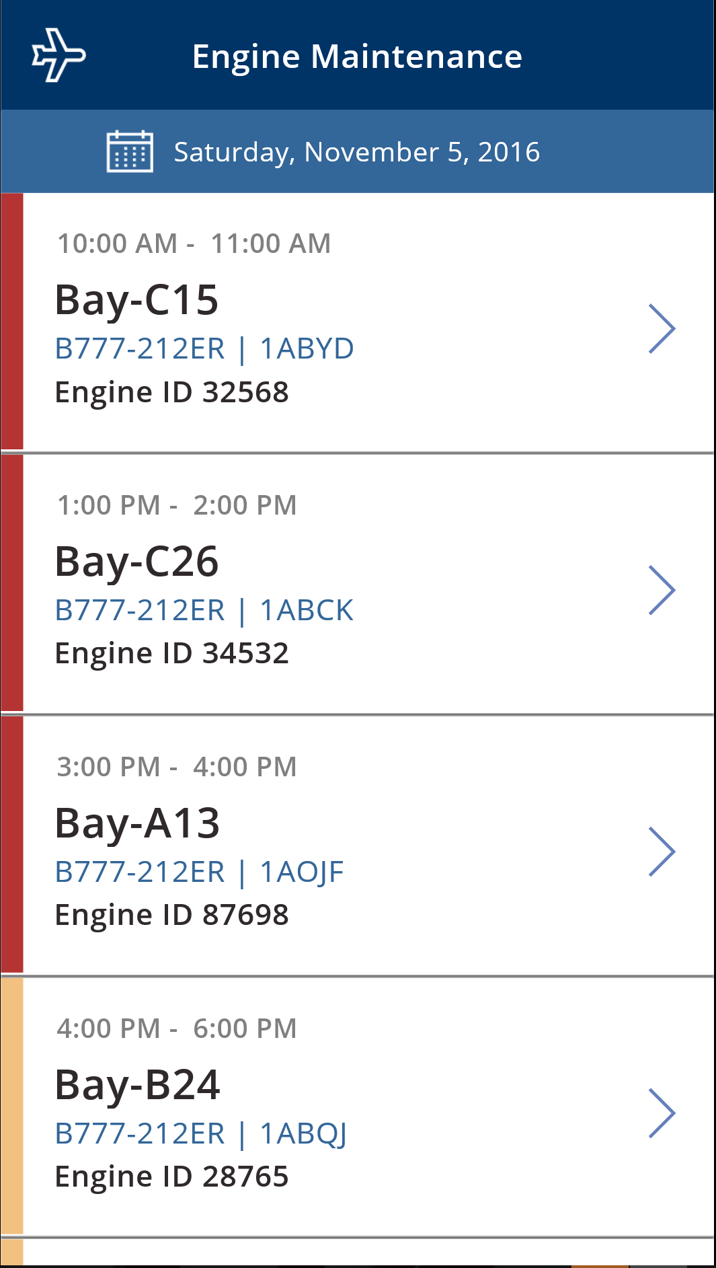
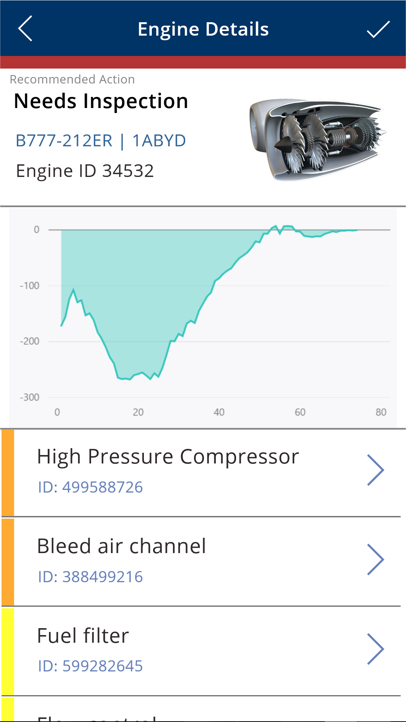
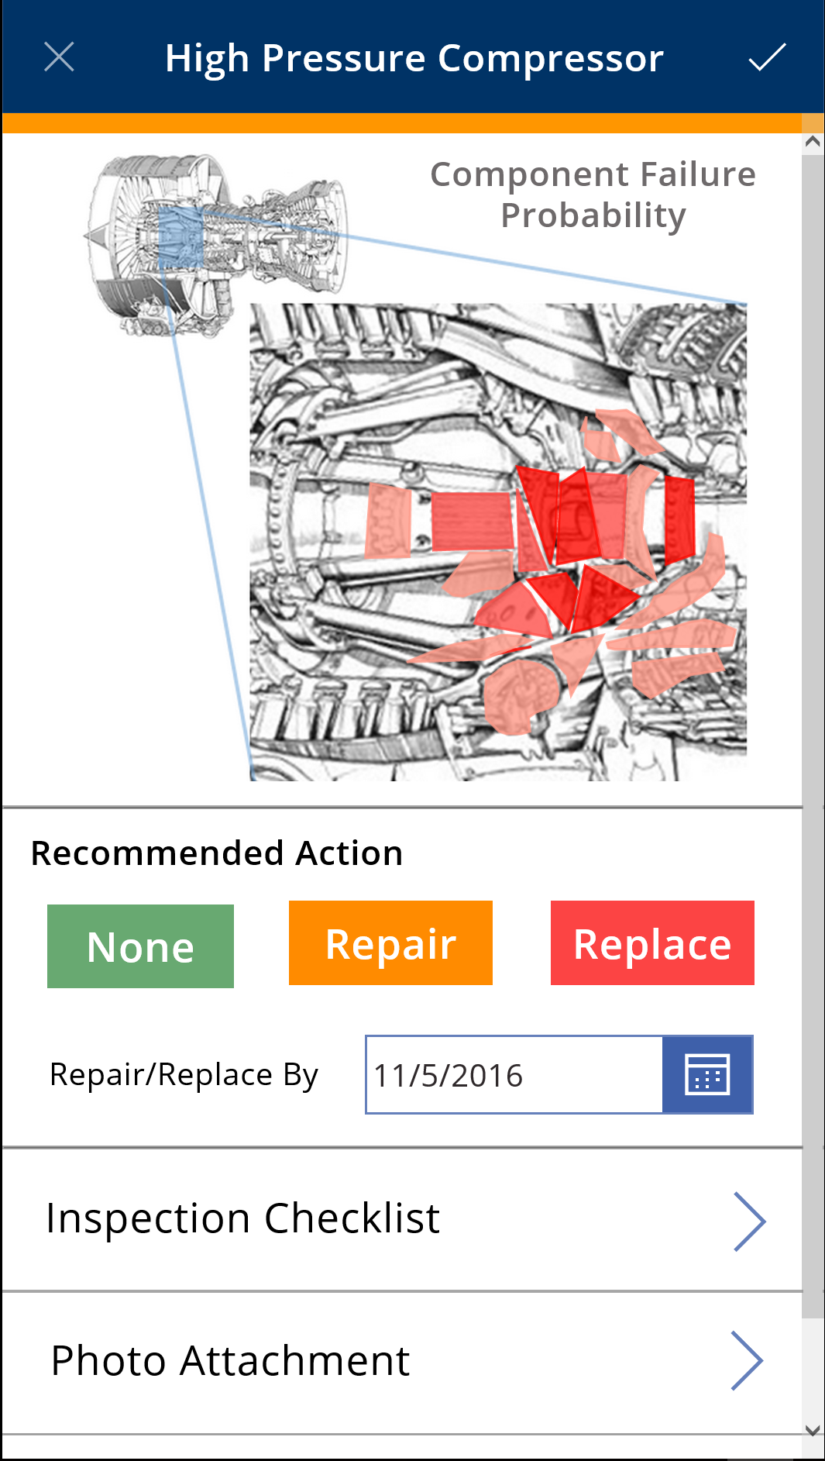
Get from insights to actions quickly
Notes:
Act & Automate: it’s not just about getting insights from your data (even though that’s a pretty big part) it’s about taking action on that insight, and even automating that action, leveraging PowerApps and Microsoft Flow

Slide 18

Notes:
Image Ref: https://customers.microsoft.com/en-us/story/virgin-atlantic-travel-and-transportation-power-apps
https://msft.today/virgin-atlantic-drives-agile-wins-for-its-mobile-workforce-with-the-power-platform/
A mobile workforce and lots of data
Building quick-win apps to help customers and employees
Putting safety first with an engineering app

Slide 19
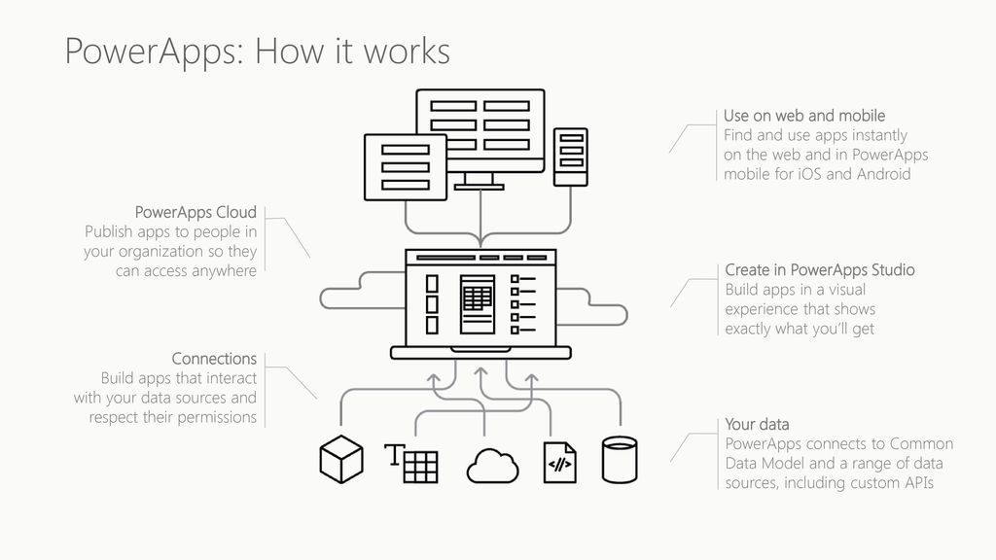

Slide 20
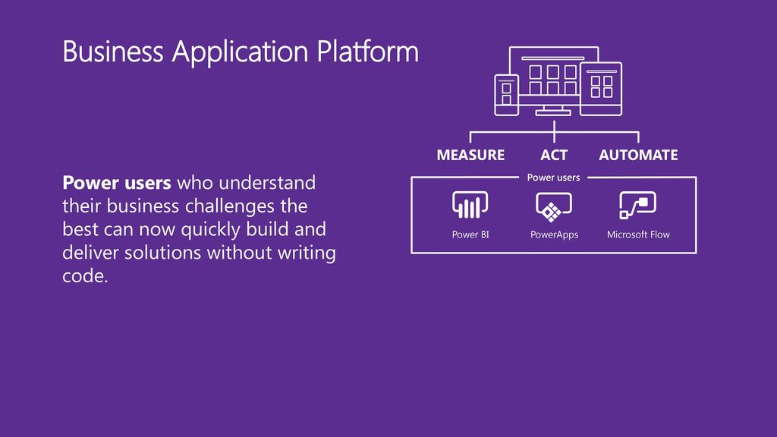

Slide 21
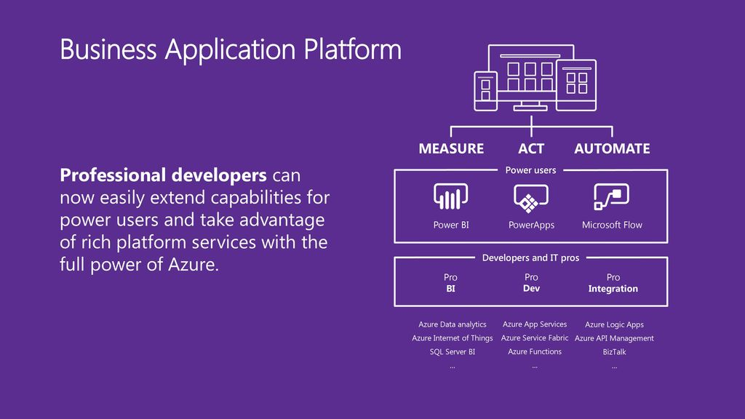

Slide 22
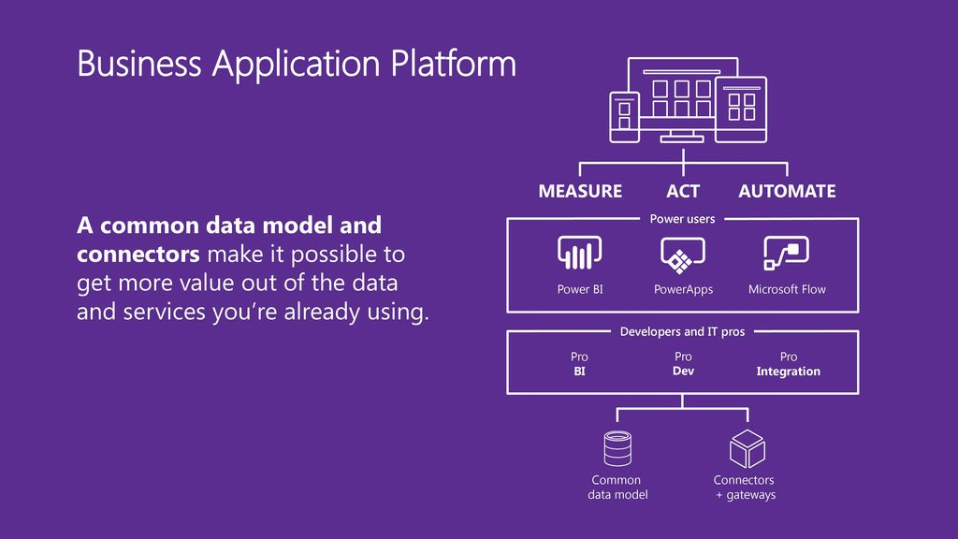

Slide 23
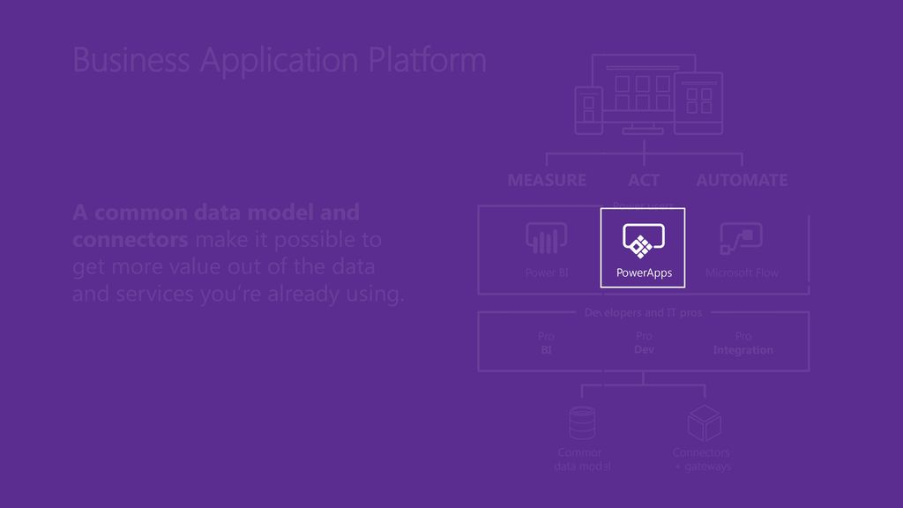

Slide 24
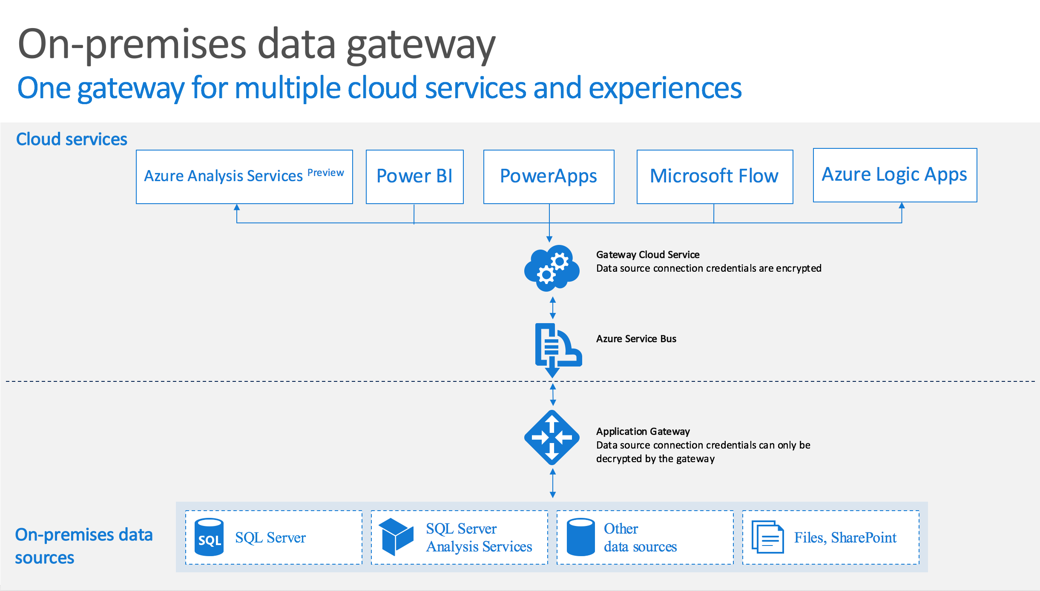
Notes:
Image Ref: https://docs.microsoft.com/en-us/powerapps/maker/canvas-apps/gateway-reference
%localappdata%\Temp\On-premises_data_gateway_*.log
%localappdata%\Microsoft\on-premises data gateway\GatewayConfigurator*.log
C:\Users\PBIEgwService\AppData\Local\Microsoft\on-premises data gateway\Gateway*.log

Slide 25

DEMO 1
Azure Data Studio
Notes:
Goto: http://powerapps.com, Sign In.

Slide 26
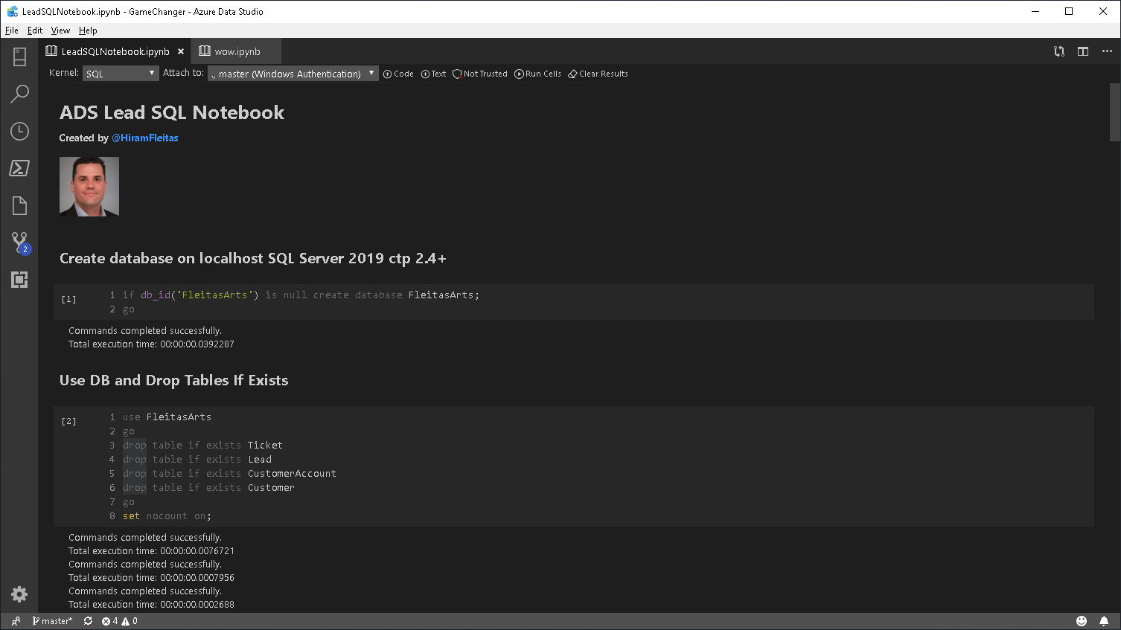

Slide 27
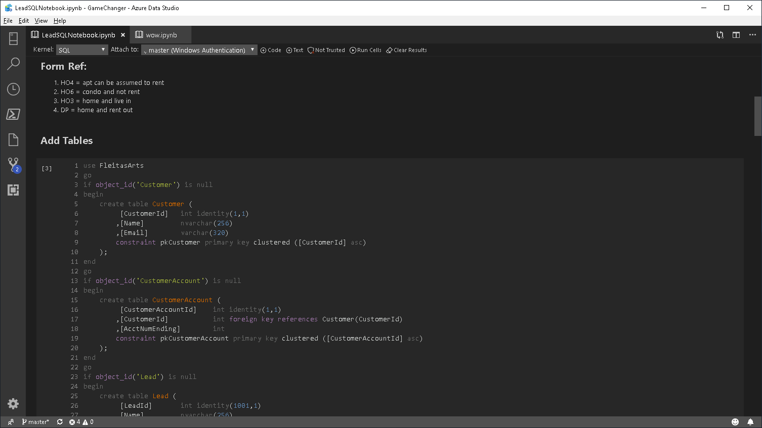

Slide 28
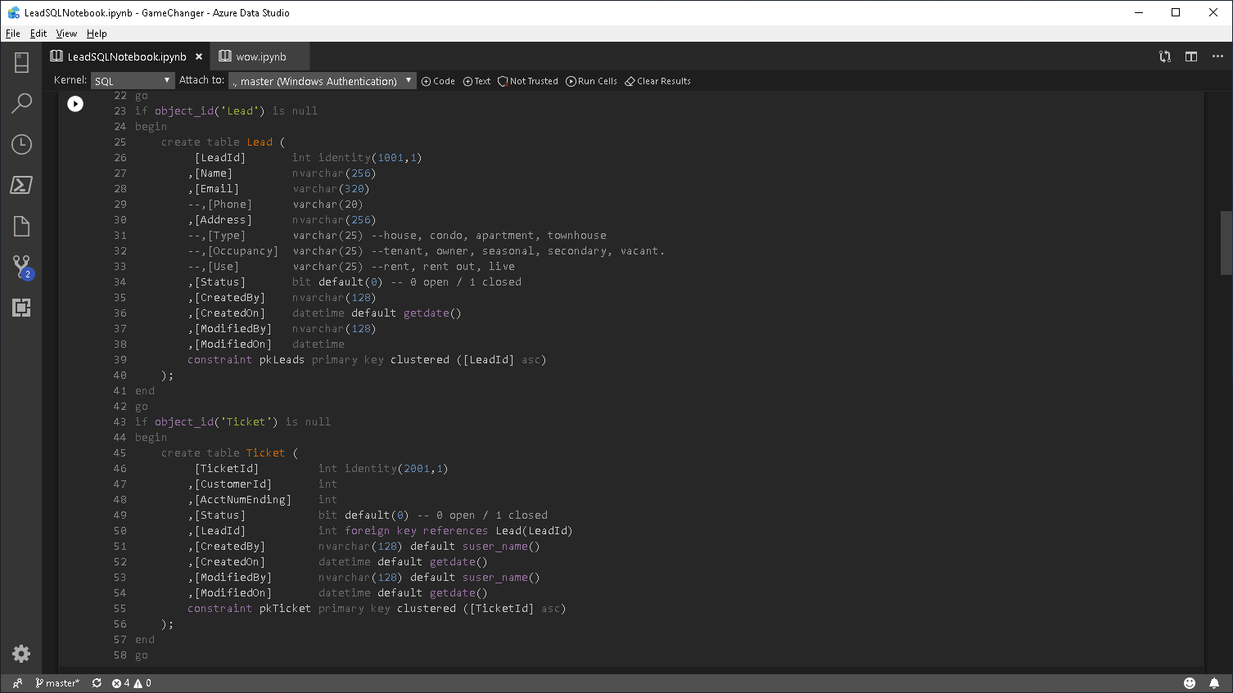

Slide 29
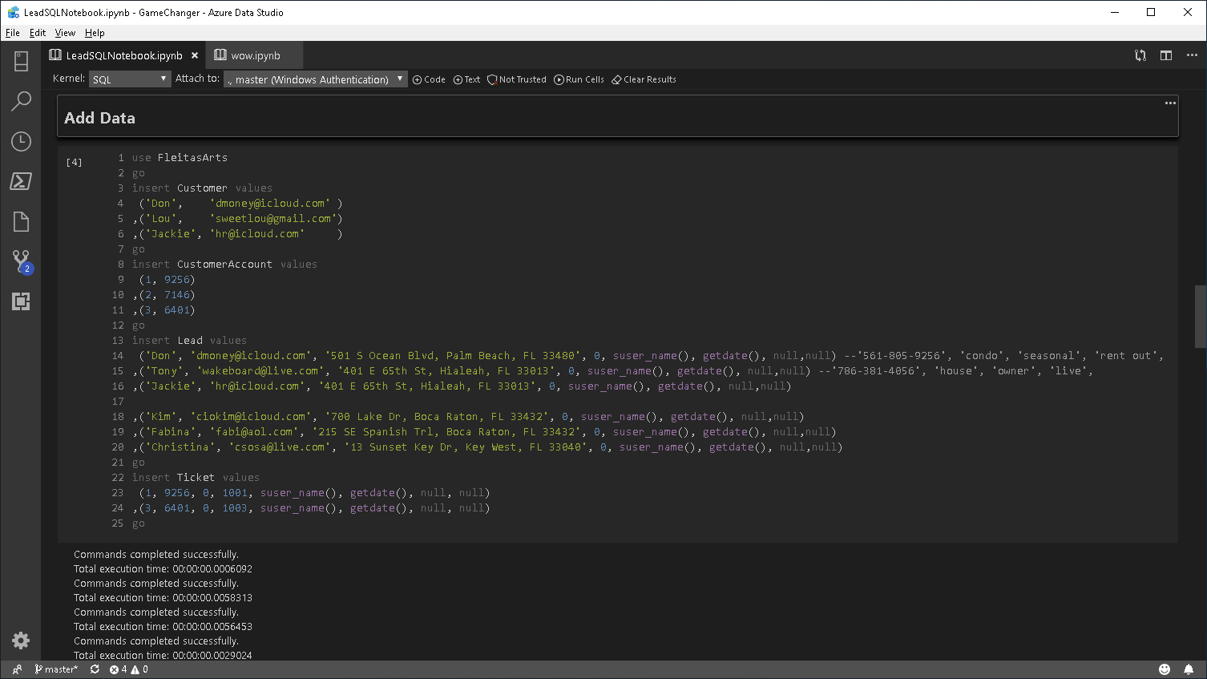

Slide 30
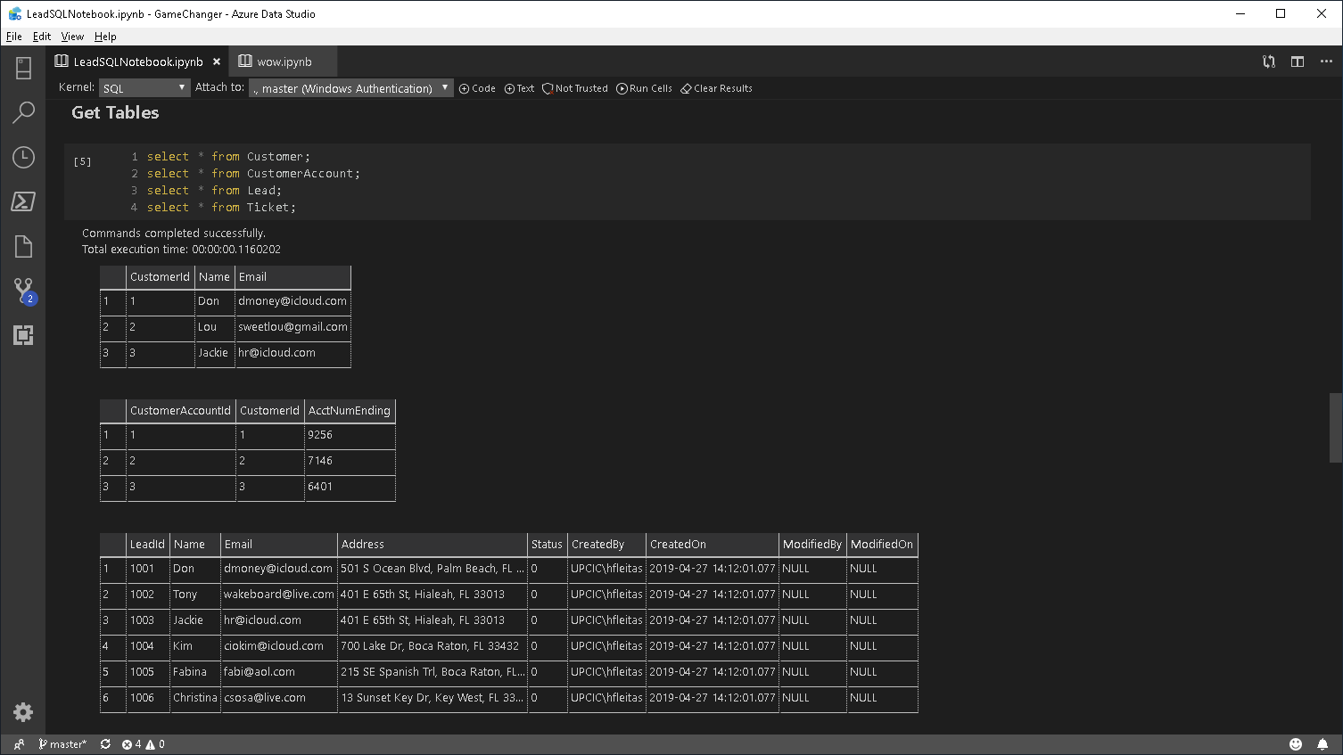

Slide 31
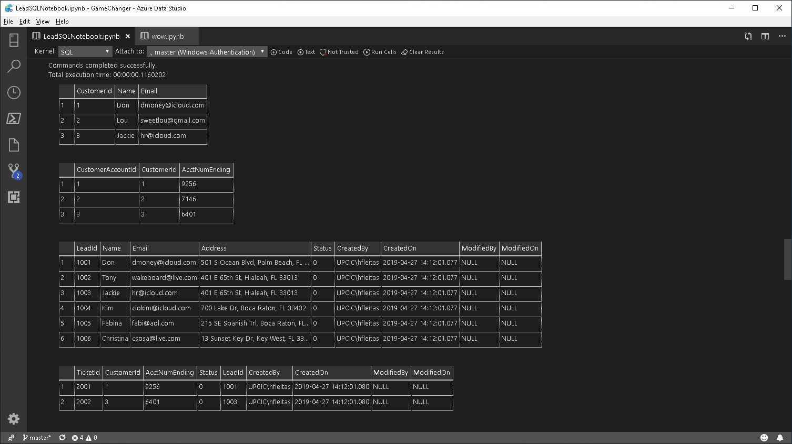

Slide 32
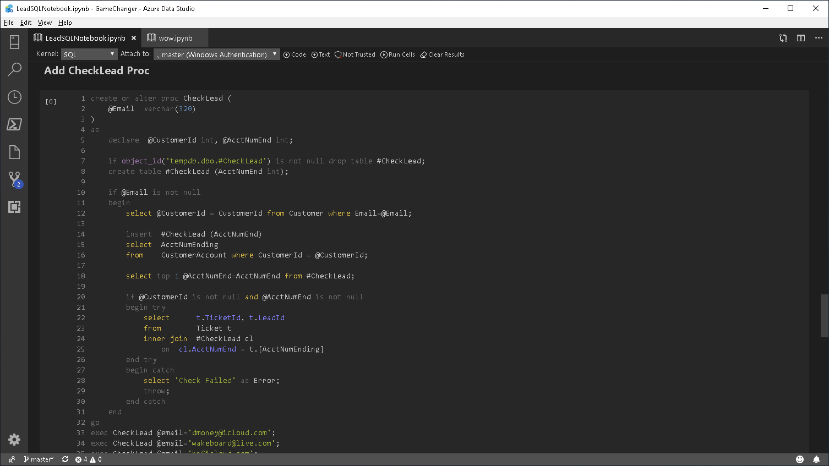

Slide 33
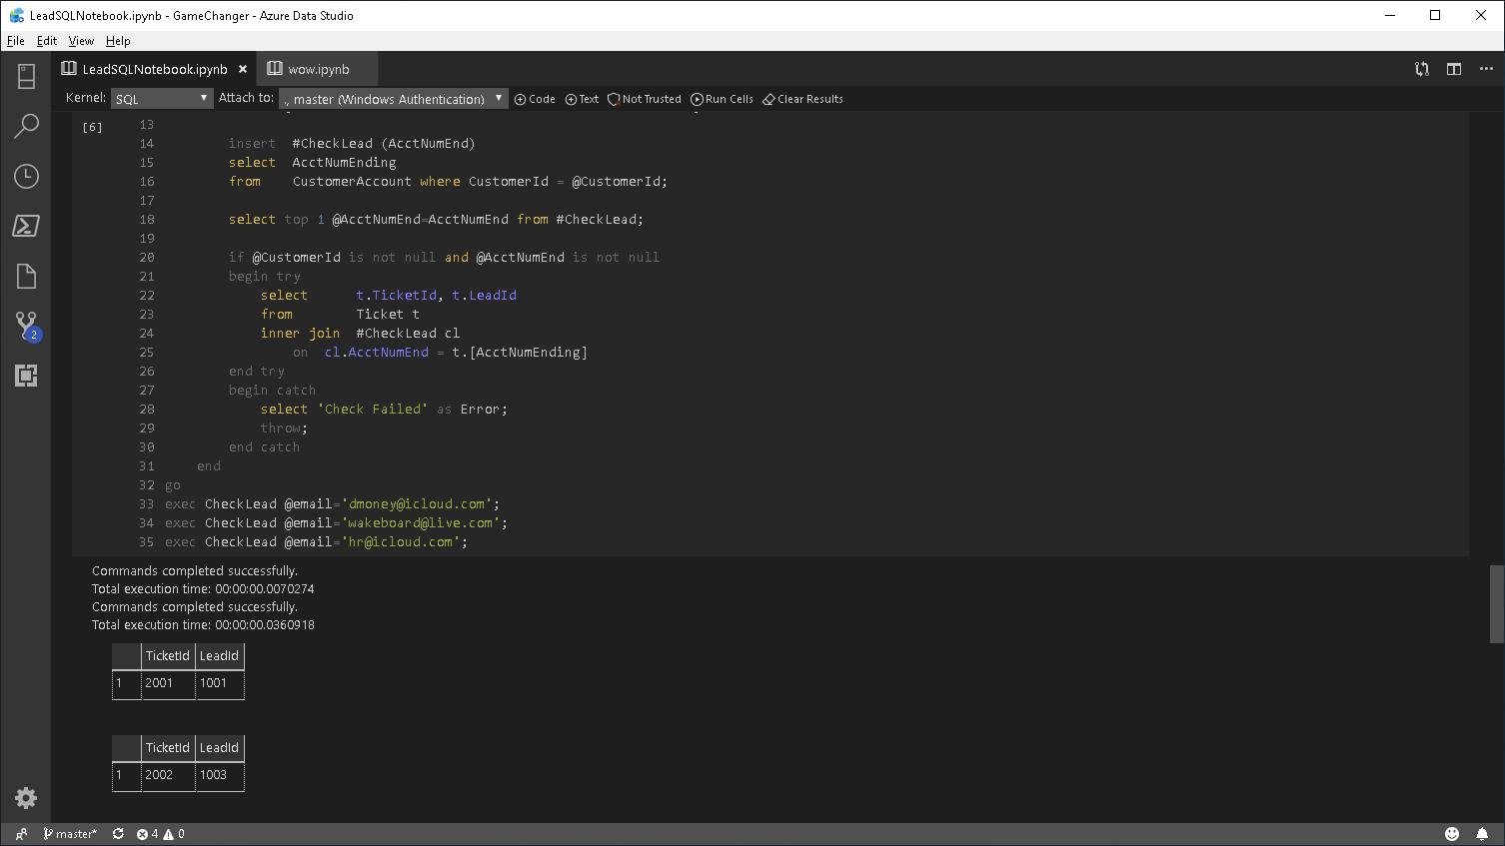

Slide 34
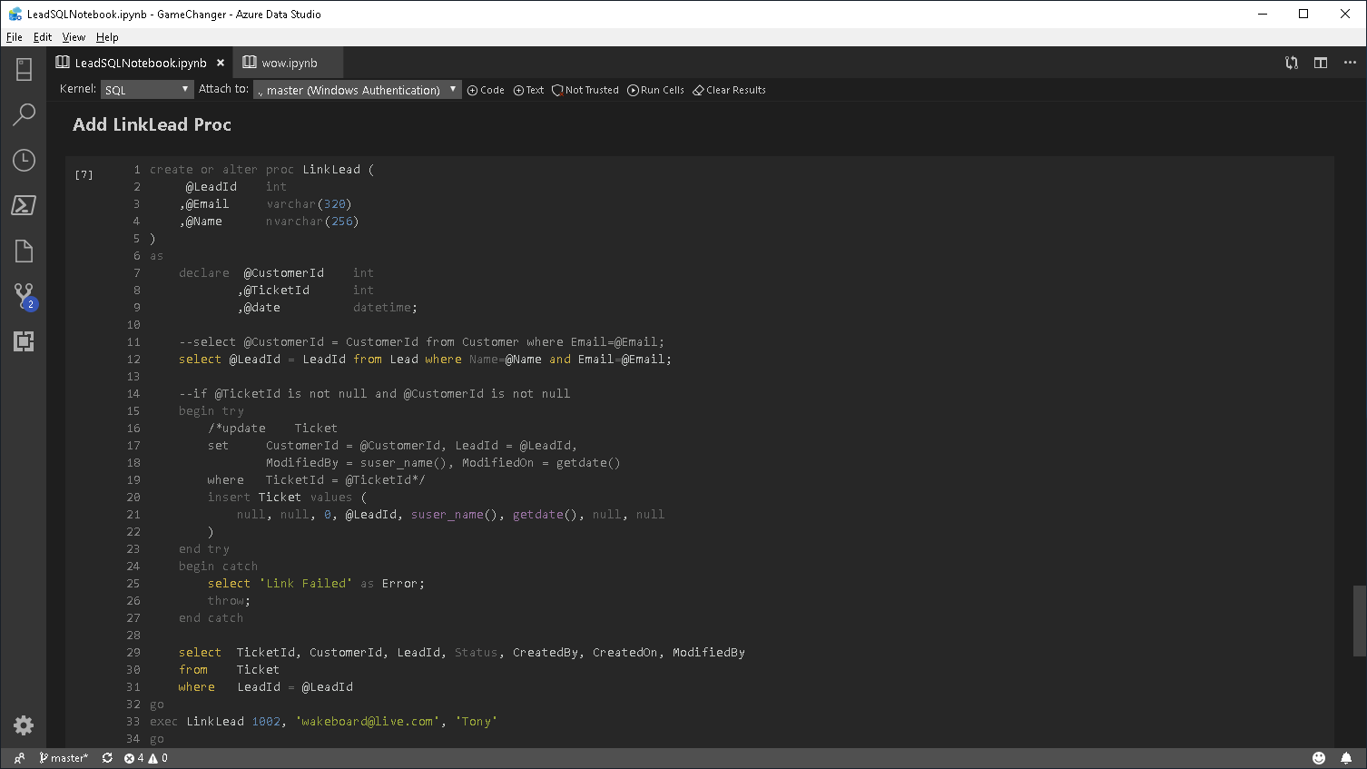

Slide 35
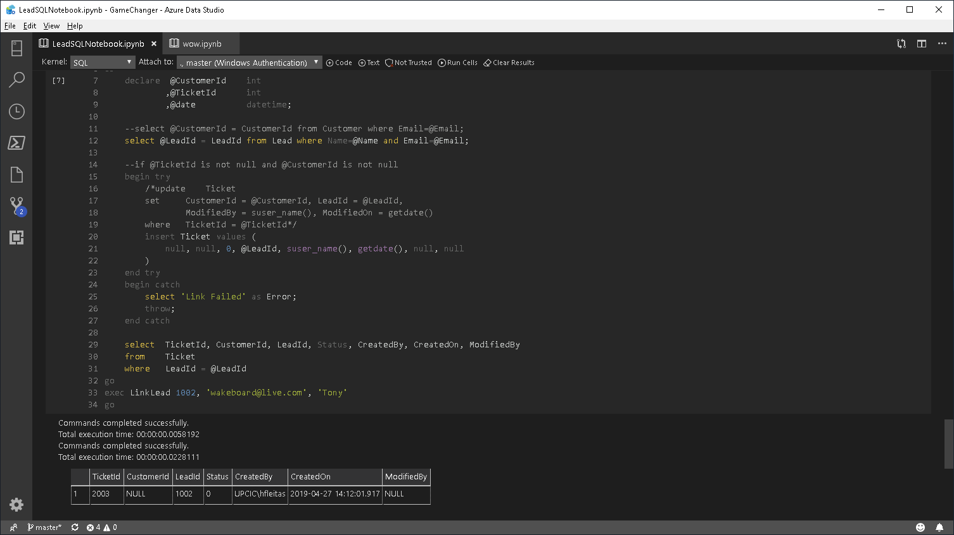

Slide 36
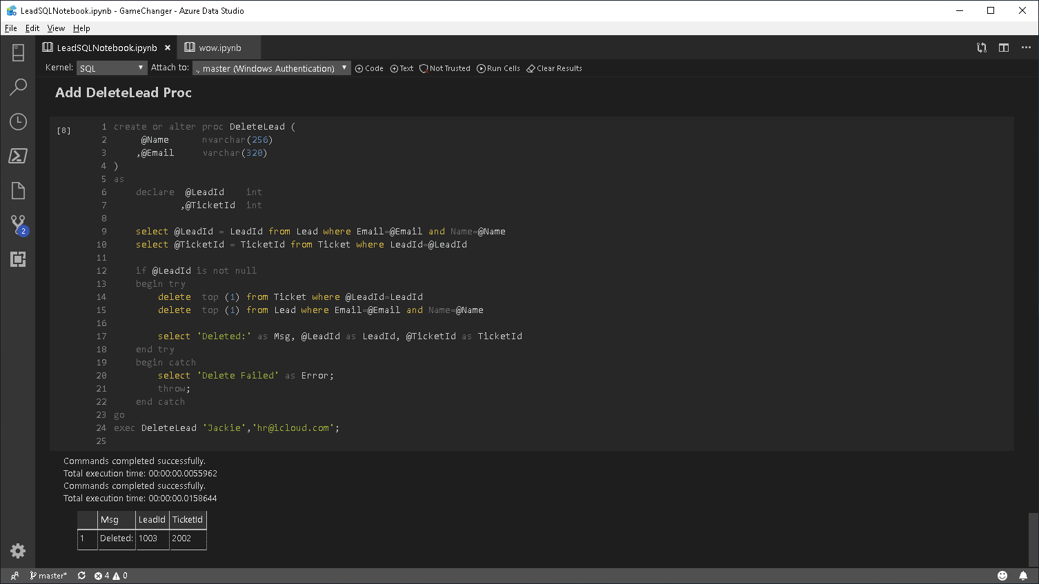

Slide 37
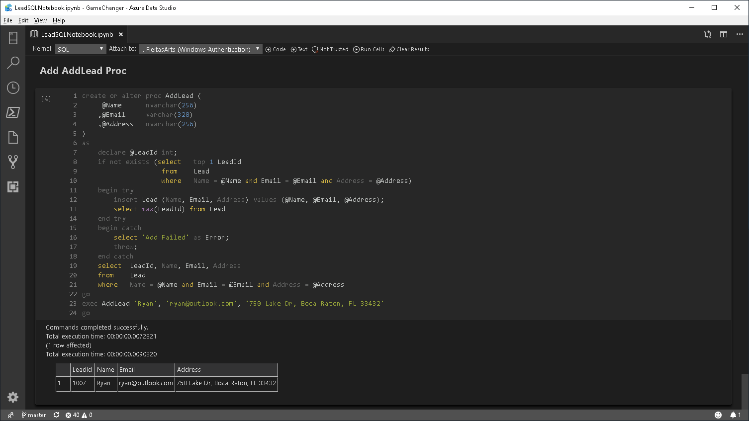

Slide 38
DEMO 2
PowerApps
Notes:
Goto: http://powerapps.com, Sign In.

Slide 39
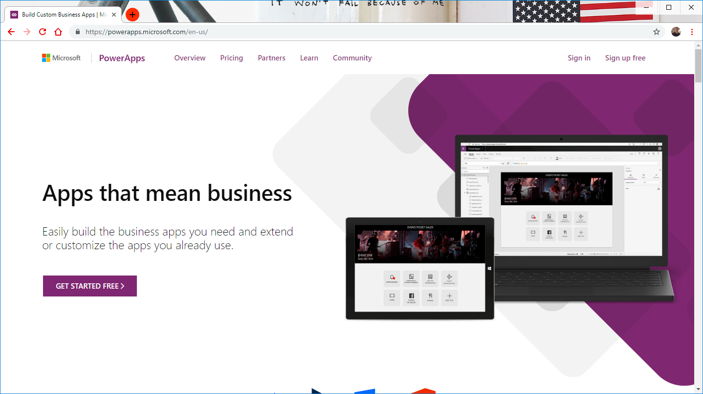

Notes:
Goto: http://powerapps.com, Sign In.

Slide 40
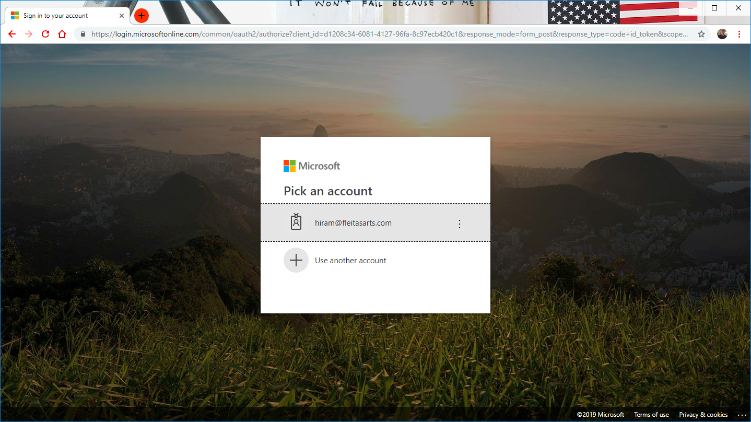
Notes:
Login: http://web.powerapps.com

Slide 41
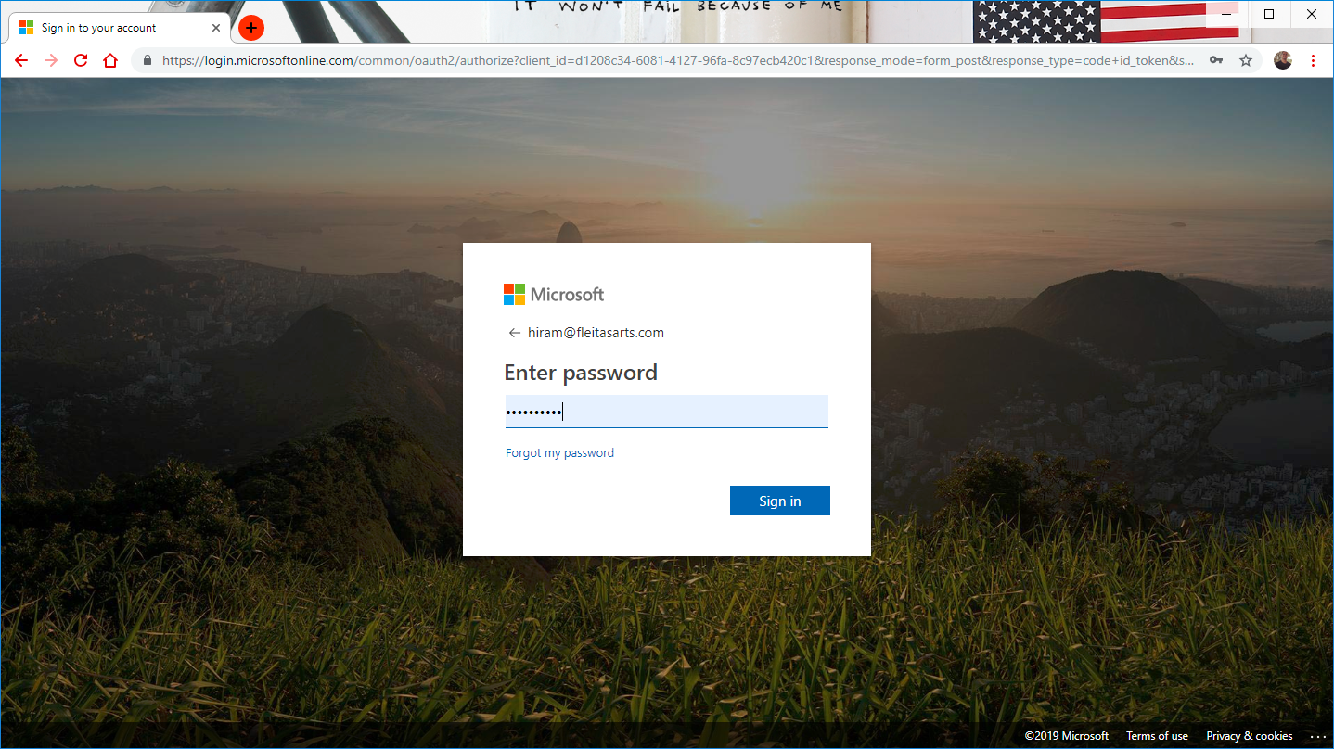
Notes:
Login: http://web.powerapps.com

Slide 42
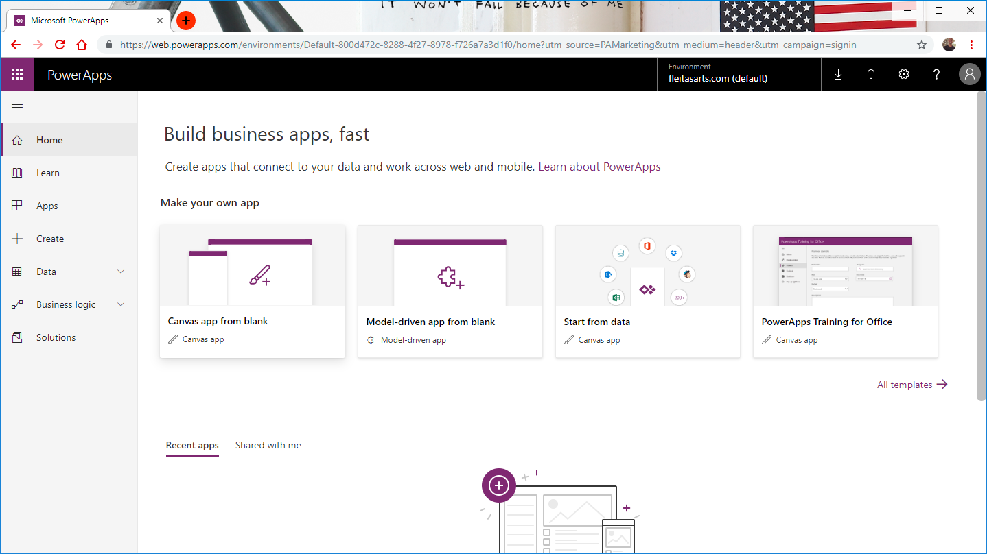

Slide 43
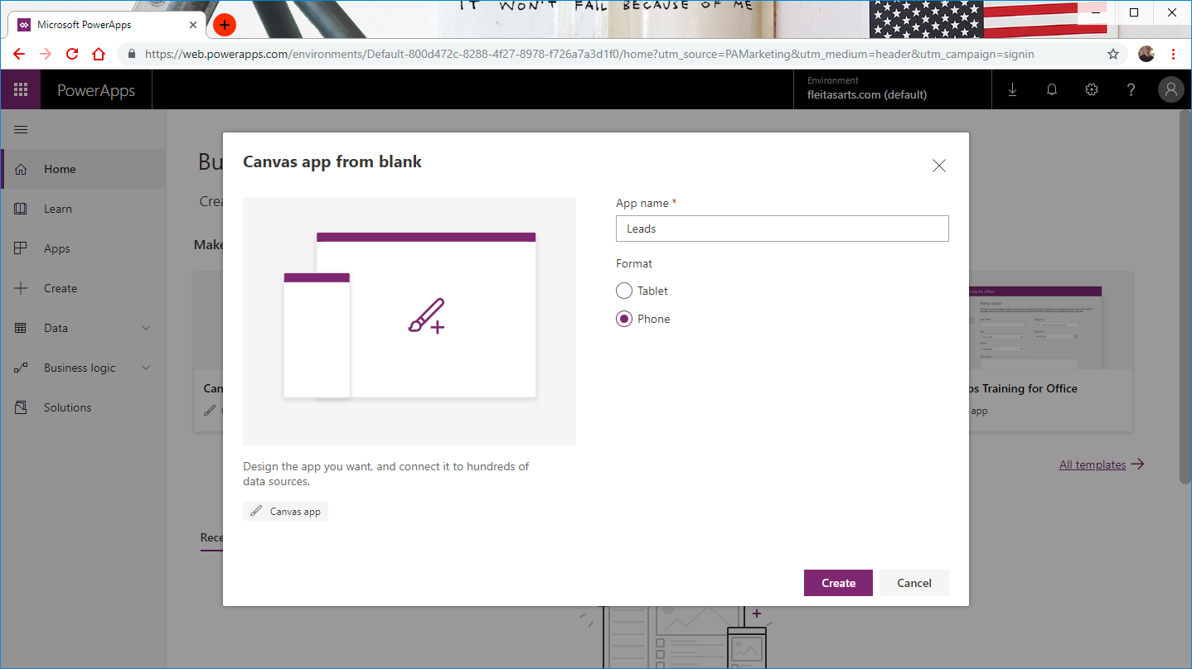

Slide 44
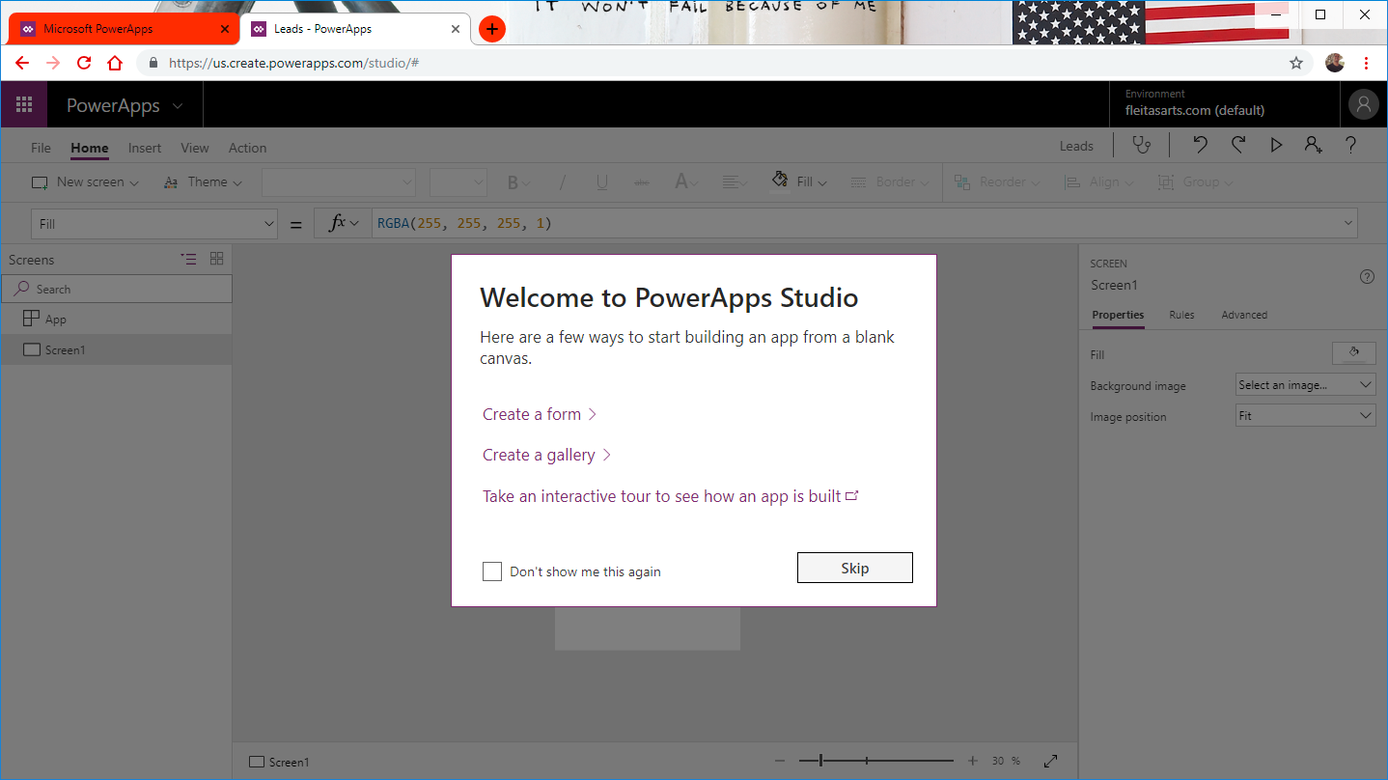

Slide 45
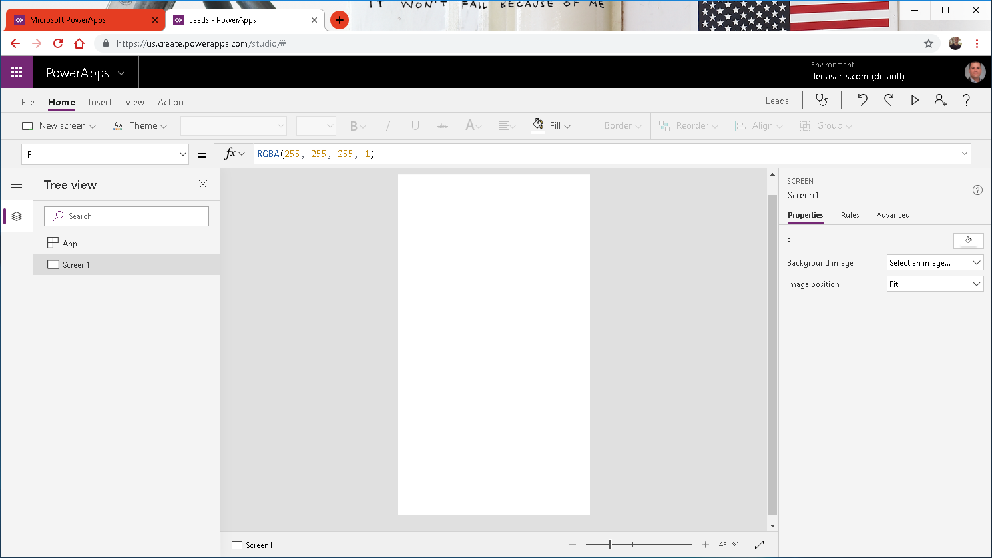

Slide 46
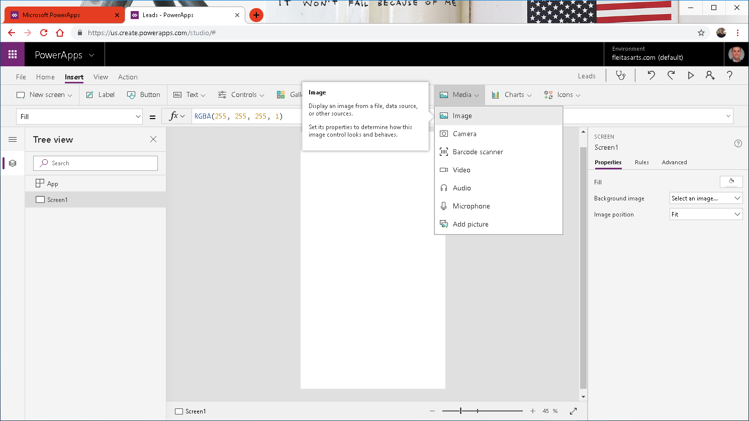

Slide 47
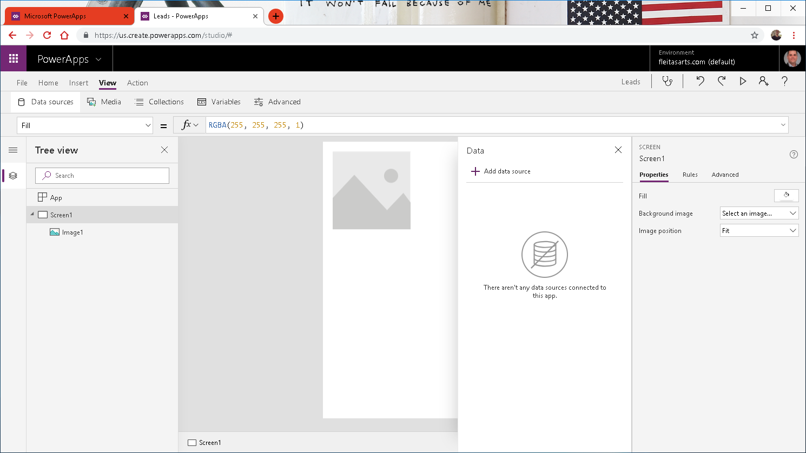

Slide 48
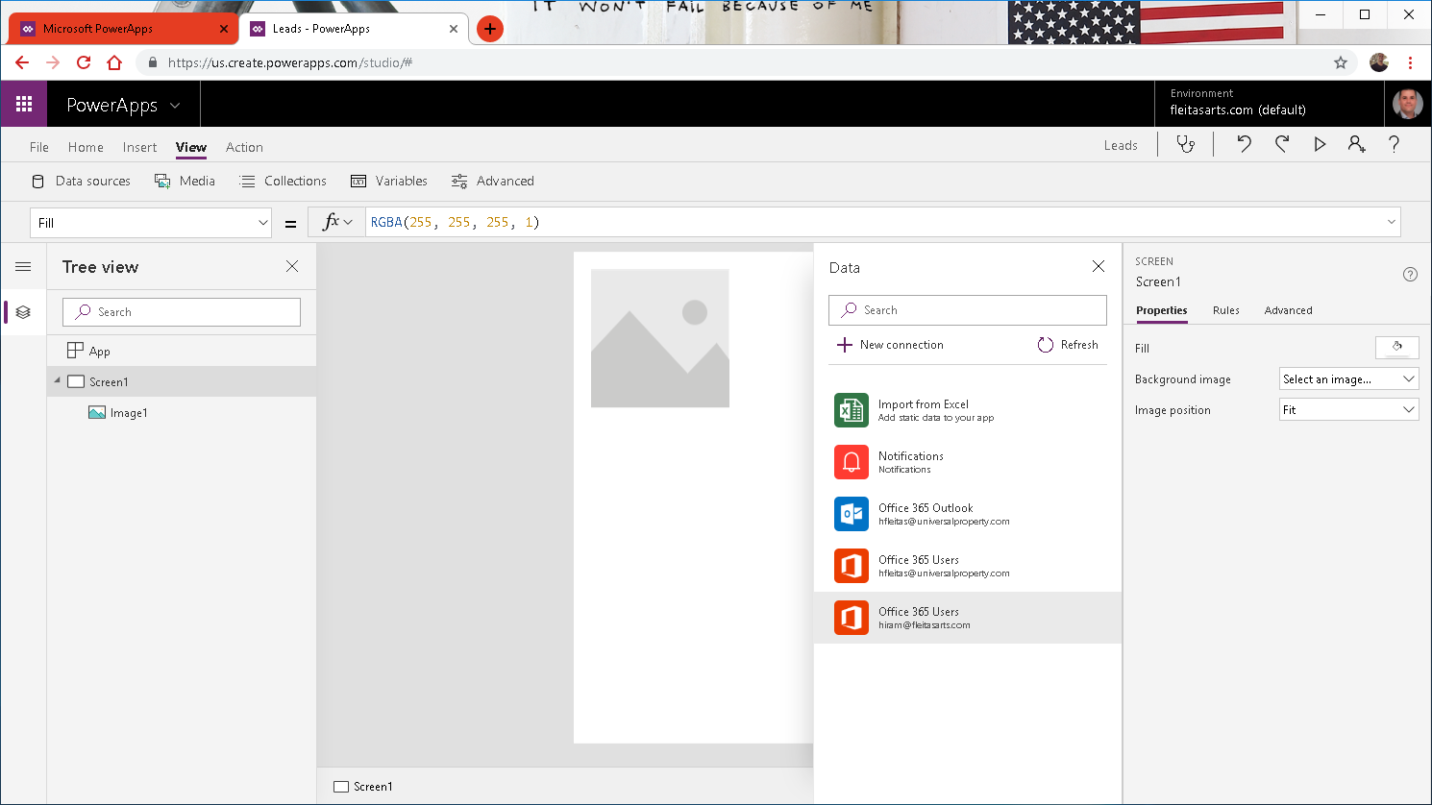

Slide 49
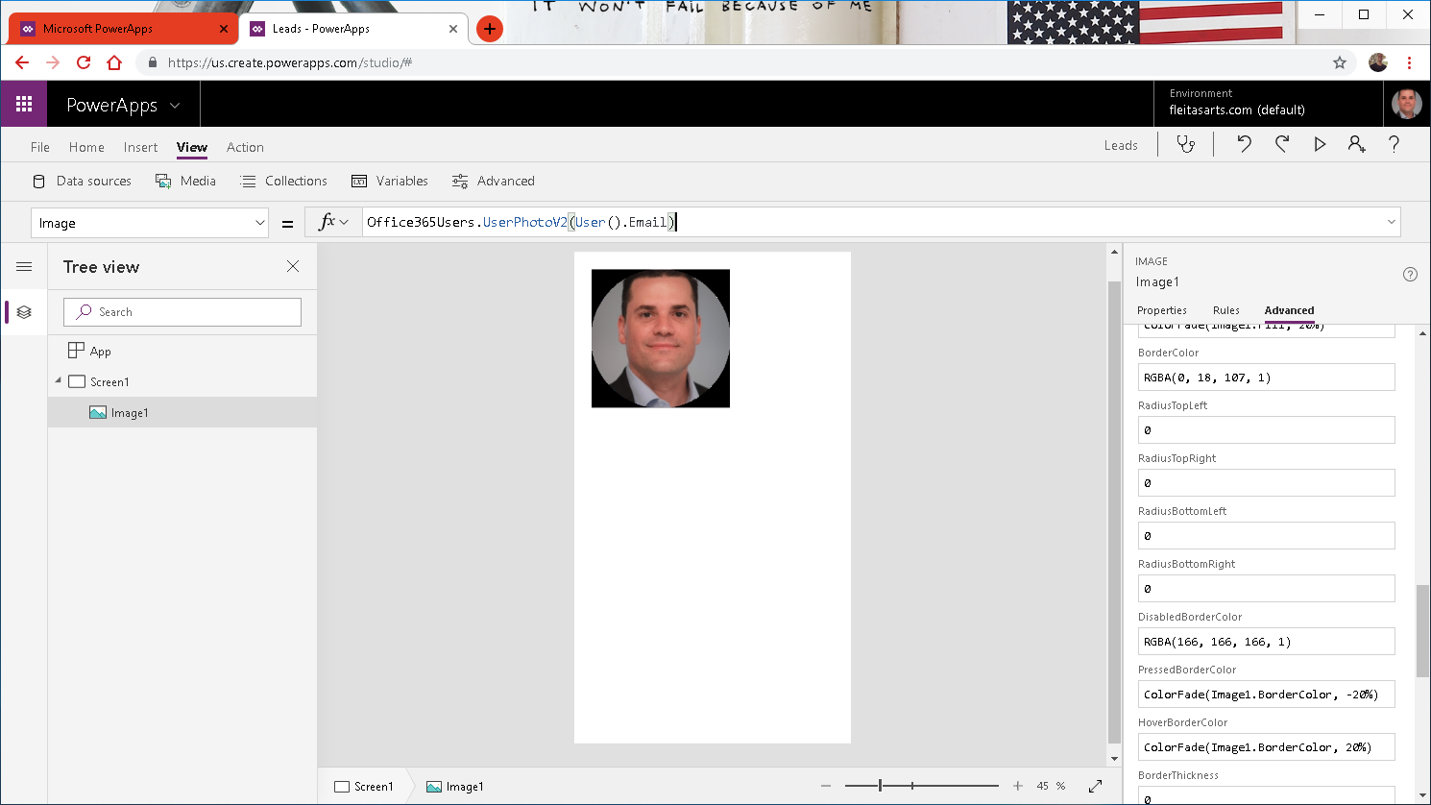

Slide 50
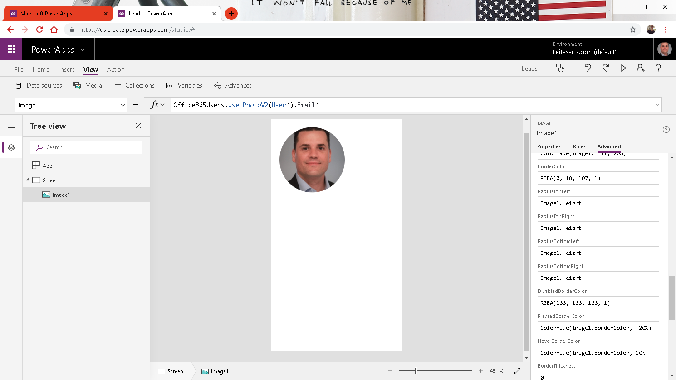

Slide 51
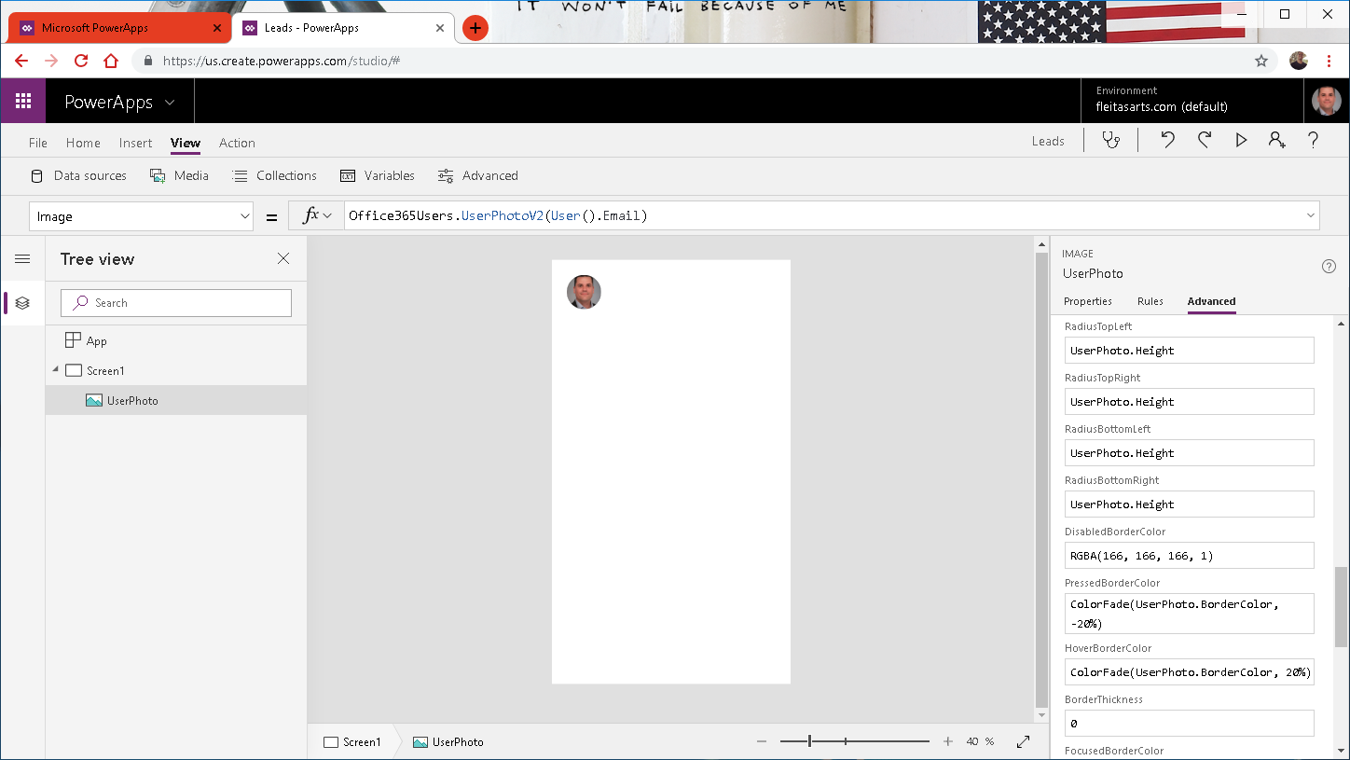

Slide 52
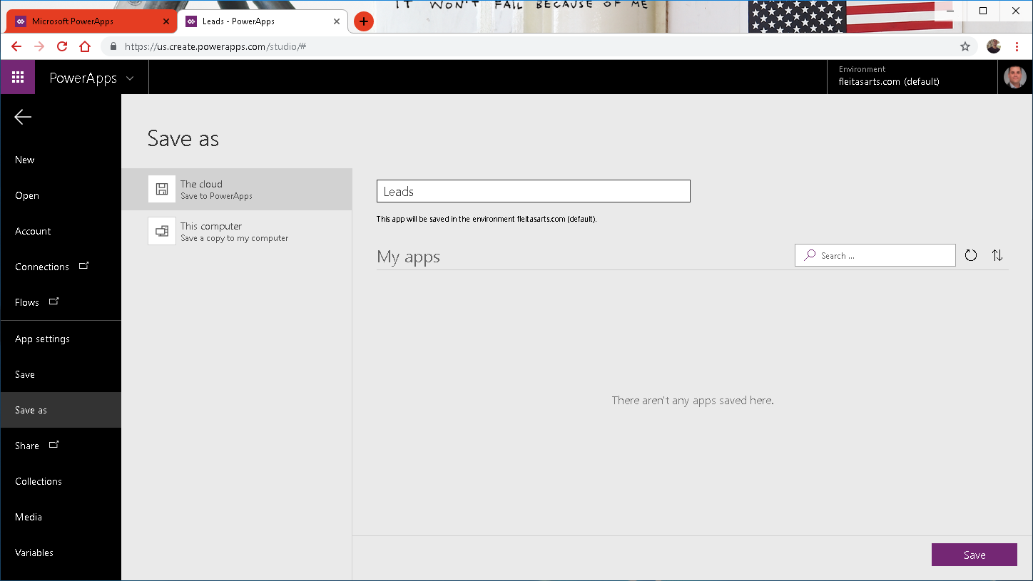


Slide 53
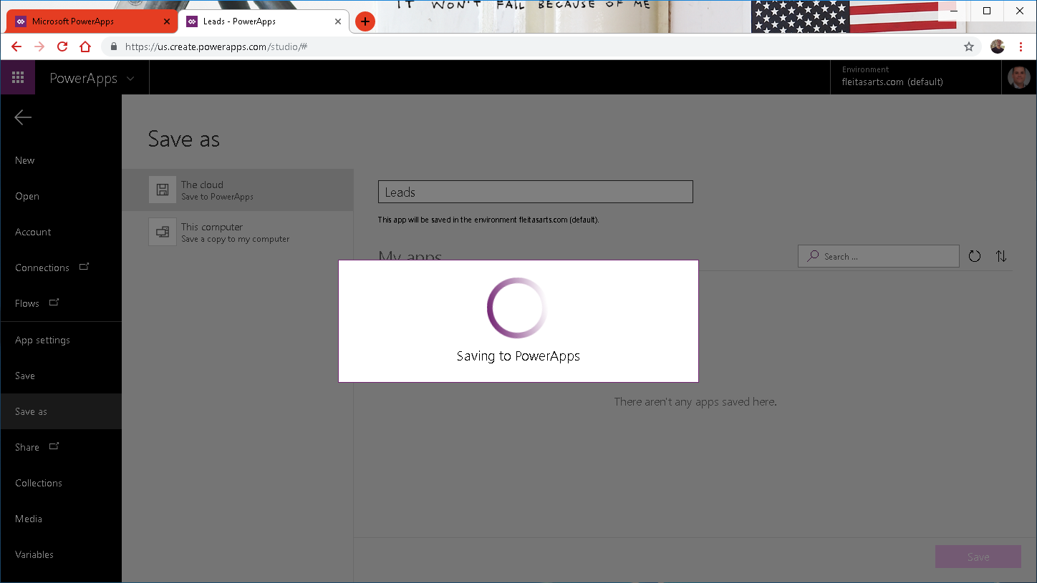

Slide 54
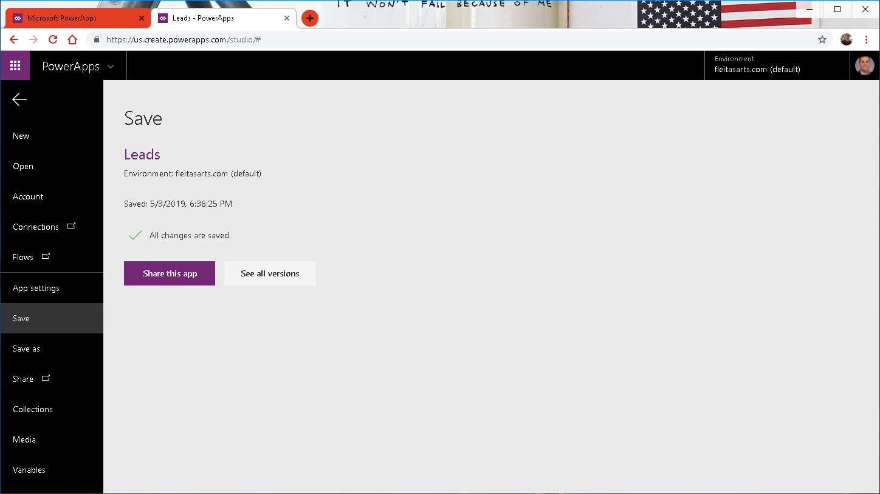

Slide 55
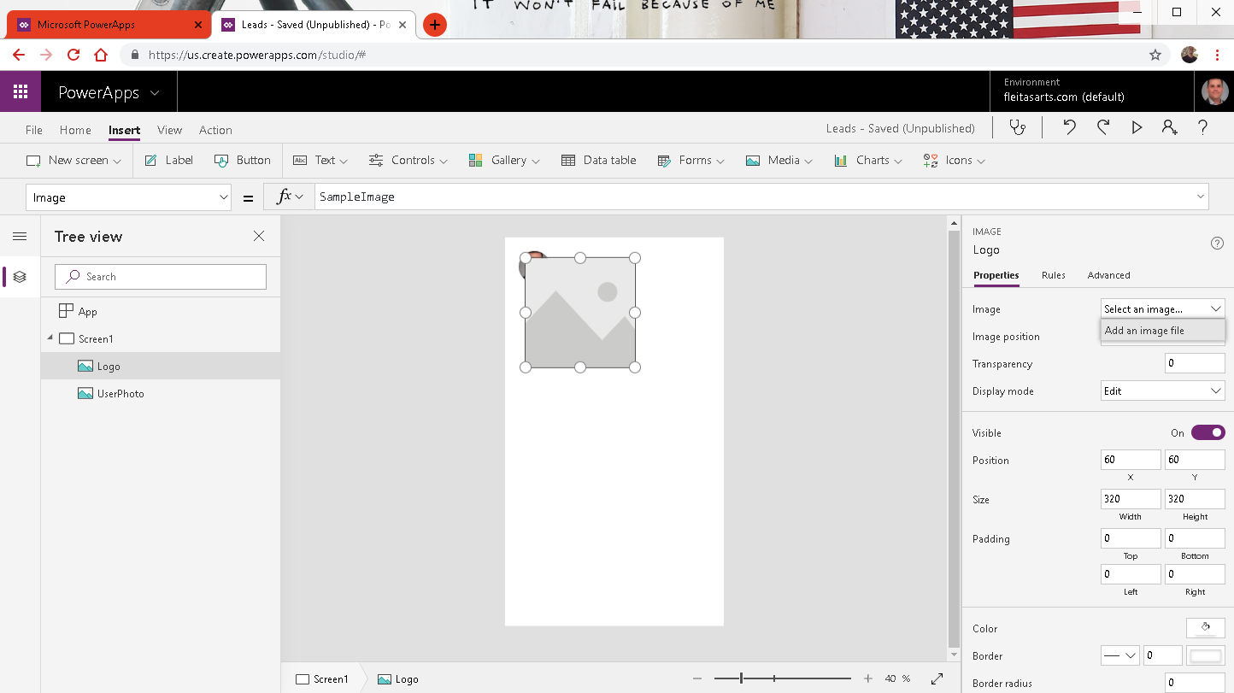
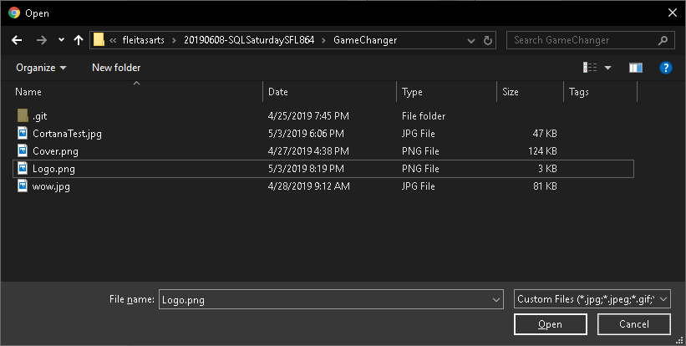

Slide 56
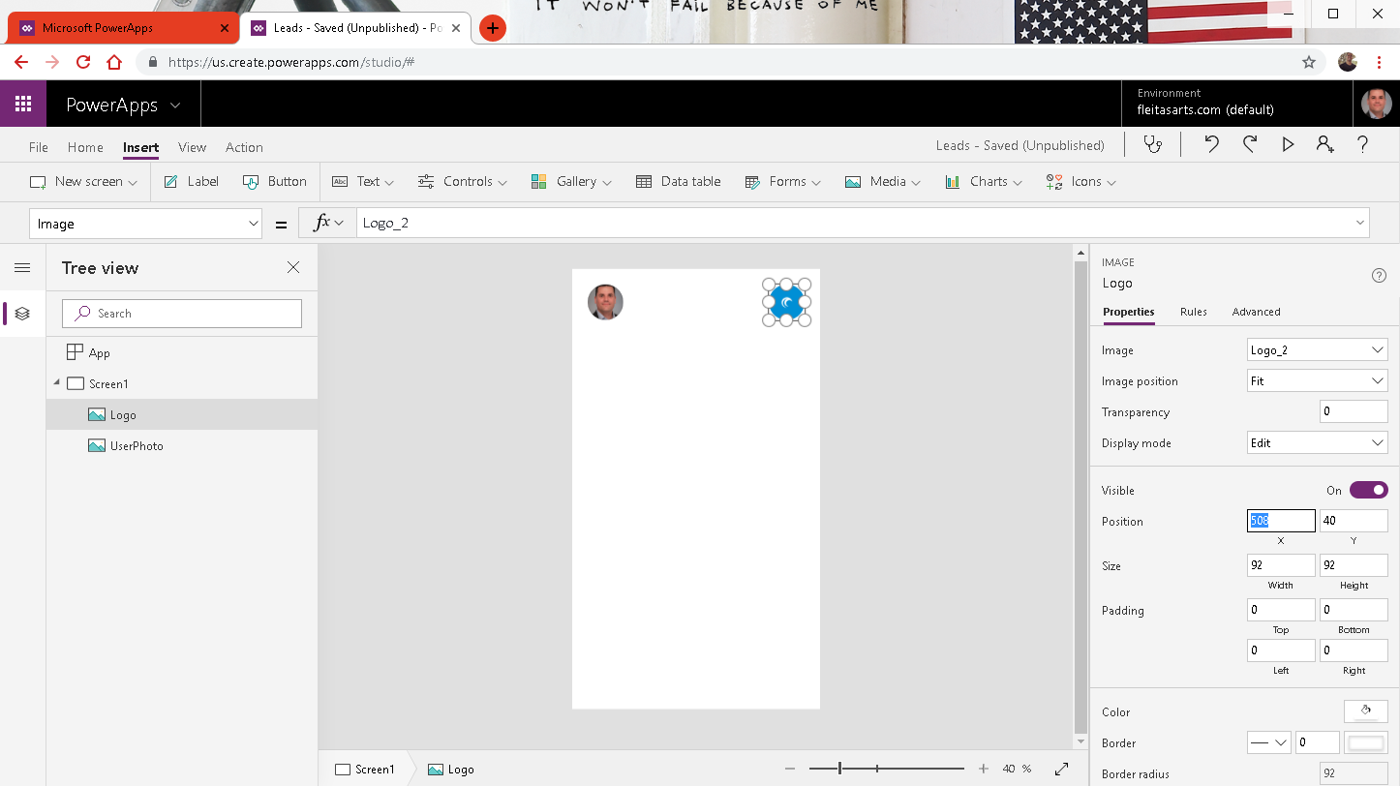

Slide 57
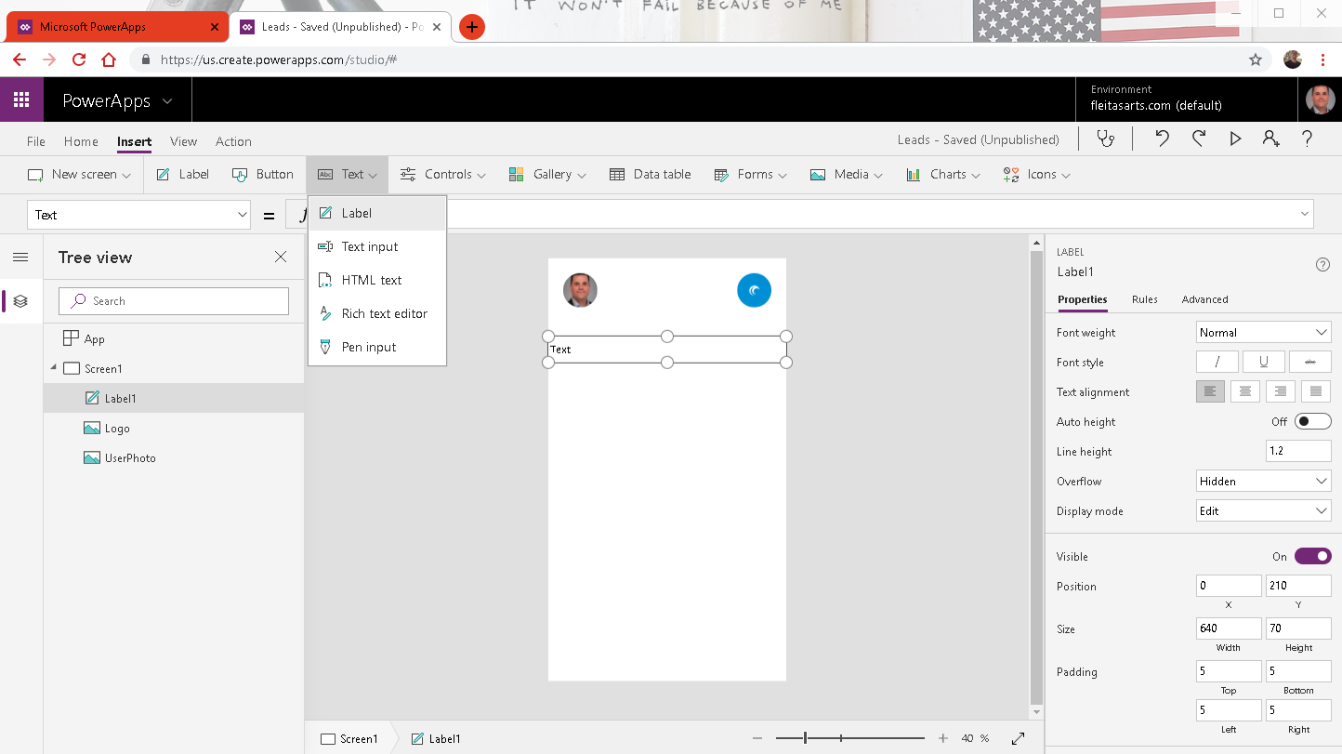


Slide 58


Slide 59

Notes:
Name, Email, Address

Slide 60


Slide 61


Slide 62


Slide 63


Slide 64

Notes:
Basic (50k/24hr, 125k/calendar yr)
Bing Maps can:
Create routes from A to B.
Give most efficient trucking routes.
Push pins on map locations.
Ref: https://docs.microsoft.com/en-us/bingmaps/getting-started/bing-maps-dev-center-help/getting-a-bing-maps-key

Slide 65

Notes:
Ref: https://docs.microsoft.com/en-us/bingmaps/getting-started/bing-maps-dev-center-help/getting-a-bing-maps-key

Slide 66

Notes:
Ref: https://docs.microsoft.com/en-us/bingmaps/getting-started/bing-maps-dev-center-help/getting-a-bing-maps-key

Slide 67

Notes:
Ref: https://docs.microsoft.com/en-us/bingmaps/getting-started/bing-maps-dev-center-help/getting-a-bing-maps-key

Slide 68

Notes:
Ref: https://docs.microsoft.com/en-us/bingmaps/getting-started/bing-maps-dev-center-help/getting-a-bing-maps-key

Slide 69

Notes:
Ref: https://docs.microsoft.com/en-us/bingmaps/getting-started/bing-maps-dev-center-help/getting-a-bing-maps-key

Slide 70

Notes:
Ref: https://docs.microsoft.com/en-us/bingmaps/getting-started/bing-maps-dev-center-help/getting-a-bing-maps-key

Slide 71

Notes:
Ref: https://docs.microsoft.com/en-us/bingmaps/getting-started/bing-maps-dev-center-help/getting-a-bing-maps-key

Slide 72

Notes:
Ref: https://docs.microsoft.com/en-us/bingmaps/getting-started/bing-maps-dev-center-help/getting-a-bing-maps-key

Slide 73

Notes:
Ref: https://docs.microsoft.com/en-us/bingmaps/getting-started/bing-maps-dev-center-help/getting-a-bing-maps-key

Slide 74

Notes:
Ref: https://docs.microsoft.com/en-us/bingmaps/getting-started/bing-maps-dev-center-help/getting-a-bing-maps-key

Slide 75

Notes:
Ref: https://docs.microsoft.com/en-us/bingmaps/getting-started/bing-maps-dev-center-help/getting-a-bing-maps-key

Slide 76

Notes:
Ref: https://docs.microsoft.com/en-us/bingmaps/getting-started/bing-maps-dev-center-help/getting-a-bing-maps-key

Slide 77

Notes:
Basic (50k/24hr, 125k/calendar yr)
Bing Maps can:
Create routes from A to B.
Give most efficient trucking routes.
Pushpins on map locations.
Ref: https://docs.microsoft.com/en-us/bingmaps/getting-started/bing-maps-dev-center-help/getting-a-bing-maps-key

Slide 78


Slide 79


Slide 80


Slide 81


Slide 82

Notes:
Ref: Integrating Bing Maps into PowerApps and Using the GPS: https://youtu.be/swpjfIyXCNA
Ref: https://docs.microsoft.com/en-us/bingmaps/rest-services/locations/find-a-location-by-address

Slide 83


Slide 84


Slide 85

Evaluate
Then true
Else false
Notes:
Pushpin: https://docs.microsoft.com/en-us/bingmaps/rest-services/common-parameters-and-types/pushpin-syntax-and-icon-styles

Slide 86

Notes:
Ref: Pushpin: https://docs.microsoft.com/en-us/bingmaps/rest-services/common-parameters-and-types/pushpin-syntax-and-icon-styles

Slide 87

Notes:
3 buttons

Slide 88


Slide 89

Notes:
Ref: Launch: https://docs.microsoft.com/en-us/powerapps/maker/canvas-apps/functions/function-param

Slide 90

Notes:
Ref: Launch: https://docs.microsoft.com/en-us/powerapps/maker/canvas-apps/functions/function-param

Slide 91


Slide 92


Slide 93


Slide 94

Notes:
Color RGBA(255,255,255,1)

Slide 95

Notes:
Fill Visual Background Color RGBA(0,0,0,0)

Slide 96


Slide 98


Slide 99


Slide 100


Slide 101

Notes:
Ref: https://uifabricicons.azurewebsites.net/

Slide 102


Slide 103


Slide 105


Slide 106


Slide 107

Notes:
Border: None
Color:

Slide 108


Slide 109


Slide 110


Slide 111


Slide 112

Notes:
I check for Email because it’s more unique vs Name or Address.

Slide 113

Notes:
The delete event could be for multiple addresses so the combination of 2 identifiers such as Name and Email get us there.

Slide 114


Slide 115

Notes:
Need to create 4 Flows:
LinkLead
DeleteLead
CheckLead
AddLead

Slide 116
DEMO 3
Microsoft Flow
Notes:
Goto: http://powerapps.com, Sign In.

Slide 117

Notes:
https://flow.microsoft.com

Slide 118



Slide 119


Slide 120


Slide 121


Slide 122

Notes:
Click Ask in PowerApps

Slide 123


Slide 124


Slide 125

body('Execute_stored_procedure')?['resultsets']
Notes:
body('Execute_stored_procedure')?['resultsets']

Slide 126


Slide 127


Slide 128


Slide 129


Slide 130


Slide 132


Slide 133


Slide 137
DEMO 4
Data Gateway
Notes:
Goto: http://powerapps.com, Sign In.

Slide 140
DEMO 5
Cortana
Notes:
Goto: http://powerapps.com, Sign In.

Slide 142




Pre-Lab Pointers

Slide 143


Slide 144


Slide 145


Slide 146



Slide 147



Slide 148
Report View
4. Visualizations
1. Ribbon
2. Canvas
5. Fields
3. Pages

Slide 150

Create visuals or
view data here
Edit report
elements

Slide 151



Slide 152

Notes:
From the ribbon select Home -> Get Data -> More…
Talk about the variety of sources supported:
• File
• Database
• Azure
• Other

Slide 153

Notes:
5 queries are created from the 1 workbook, a csv file and a folder data source.
There are data preparation and transformation options.
• Add/Delete Columns and Rows
• Change Data Type
Select Sales query
83. Walk through the APPLIED STEPS
84. Talk about Append in Sales and difference between Append and Merge
85. Talk about Add Conditional column
86. Talk about Query Dependencies
87. Close Query Editor window
88. If you have time, talk about data transformations performed in the other queries

Slide 154

Notes:
Operations under Transform menu

Slide 155

Notes:
Operations under Add Column menu

Slide 156

Notes:
Navigate to Relationships section
90. Talk about the relationships that are created to connect all the queries
91. Click on Manage Relationships and show the dialogue
92. Talk about 1:1 and 1:M relationships that are supported by Power BI Desktop
93. Depending on the audience might want to talk about bi-direction relationship
94. Talk about Synonyms

Slide 157


Slide 158

Hide Ribbon
Report View
Right click
Notes:
95. Navigate back Reports section,
96. Talk about Fields and Visualization section
97. Talk about ability to Hide/Unhide fields and tables

Slide 159

Notes:
Navigate to By Manufacturer report page
Notice we already have a drill through by Country.
This is known as a drill through report, but we also want to drill through by Manufacture.

Slide 160

Notes:
Simply drag the Manufacture field/column into drill through.
And now we can drill through into this page by Manufacture.
Do not apply any filters for manufacture at this point.
Note also the Card Display says Manufacture Analysis.

Slide 161

Notes:
The Card Display is not filtered at this point is for ALL manufactures.
We can go back to the Market Share page, right click a manufacture
and Pass-Through the value into this page.
Let’s go back to Market Share report page and see that in action.

Slide 162

Notes:
Notice in % Growth by Manufacturer column chart, Currus has the best growth. Let’s investigate.

Slide 163

Notes:
Right click on Currus bar and select Drillthrough -> By Manufacturer to be navigated to By Manufacturer page

Slide 164

Notes:
Click Focus mode

Slide 165

Notes:
These icons show that there is a hierarchy of these 3 fields (Products -> Segments -> Category)
They also indicate whether we’ve drilled down or up on this visual.

Slide 166

Notes:
Click New Page. Leave it as Page 1 for now.
From By Manufacturer page copy the Manufacturer logo slicer.

Slide 167

Notes:
Lets copy the logo slicer Ctrl + click the arrow to show the logos and click Copy.

Slide 168

Notes:
Paste, and Sync the slicer.

Slide 169

Notes:
Click View, check Sync slicers, this will the Sync Slicer panel.
Meaning whatever we choose this visual will be synced back to the same visual slicer in the By Manufacture page.
Affects the assigned pages.
117. Filter by Currus

Slide 170

Notes:
Lets use the Q&A feature by click Ask A Question or simply double click on the canvas.

Slide 171

Notes:
Enter % Growth by Country
Notice Currus has a big presence in Mexico
Resize it to see the distribution better and lets add a slicer.

Slide 172

Notes:
Click Slicer and lets filter by Year.

Slide 173

Notes:
This is a numeric rage slicer, notice how it affects the other visual % Growth by Country on our page.
We can switch this to a drop down or list.

Slide 174

Notes:
Click to change the type of slicer and choose Dropdown.

Slide 175

Notes:
The dropdown is nice to save space on the canvas.
But a list can be made to look very interesting.

Slide 176

Notes:
Select 2017 in the slicer.
Notice that Currus had a big impact in Nigeria in 2017

Slide 177

Notes:
Lets set the type of slicer to a list.

Slide 178

Notes:
Click Format, and change the Orientation from Vertical to Horizontal.
We get this look & feel as if it was a button!

Slide 179

Notes:
Here I’ve resized it and lets change the colors.

Slide 180

Notes:
Click Format, under Items, change the Font Color to white to standout, and Background to blue as the other visual.

Slide 181

Notes:
Notice how Nigeria had negative growth in 2016.

Slide 182

Notes:
Create a matrix visual with Product Hierarchy in Rows and Revenue and PY Revenue in Values section

Slide 183

Notes:
Create a matrix visual with Product Hierarchy in Rows and Revenue and PY Revenue in Values section

Slide 184

Notes:
131. Apply conditional formatting on Revenue so that Revenue is formatted based on % Growth. Thus, highlighting capability to format based on another field

Slide 185

Notes:
Click the down tick next to the Revenue value, select Conditional Formatting, Background color.

Slide 186

Notes:
Choose Based on % Growth
check Diverging to add a Mid value color.
And click OK.

Slide 187

Notes:
I’ve increased this visual’s Font size format for Column headers, Row headers, and Values to make this legible.

Slide 188

Notes:
Select Nigeria in the bar chart and notice that Currus has growth in Urban and Youth Product categories.
You’d expect it to have been Rural, since it has a higher Revenue, but the contributors to the Growth were Urban and Youth.
133. investigate further by drilling down the Product hierarchy

Slide 189

Notes:
Investigate further by drilling down the Product hierarchy.
We can see for the Urban category the contributors to the % Growth were Convenience and Extreme segments.

Slide 190

Notes:
Move things around and resize them to give some room.
Then add a Scatter chart visual, and add Units to the X-Axis.

Slide 191

Notes:
Set the calculation to Average of Units instead of the default Sum.

Slide 192

Notes:
Do the same for Average Revenue to he Y-Axis

Slide 193

Notes:
From the Fields section, add Product to Details

Slide 194

Notes:
Lets leverage the Power BI underlying clustering algorithm by telling the Scatter chart to Automatically find clusters.
Click the ellipses on the top right of the visual for More Options and choose Automatically find clusters.

Slide 195

Notes:
Cluster dialog opens. Change the number of clusters if you wish to, if not leave the default and click OK.
It’s going to say Working… for a moment.

Slide 196

Notes:
Notice the Scatter chart has updated to show clusters using the clustering algorithm.
You can use clusters to identify outliers and patterns.

Slide 197

Notes:
Select the outlier Cluster7 in the Scatter chart.
Notice they make a huge chunk of the revenue in Nigeria and Canada.
Something to look into…

Slide 198

Notes:
If we sort by Revenue the product matrix we see Currus UC-26 is the outlier in Cluster7 with the highest Average of Units and Average of Revenue in Nigeria and Canada.

Slide 199

DEMO +
Slicer Between
Bookmarks
Analytics
Mobile
Notes:
So what’s going on and is there a correlation with social media?

Slide 200

Notes:
Note: This demo is to show slicers is available on numeric and dimension fields
147. Add a Revenue slicer
148. Let’s use the slicer to take out the outliers
149. Use the slicer to keep Revenue between 1000 and 40000.
150. Notice with this selection, Germany, Japan and Mexico have negative growth

Slide 201

Notes:
151. Enable Bookmark pane.
152. Walk through the existing Bookmarks and the use case for bookmarks.
153. Feel free to add new bookmarks for Currus story that we started investigating

Slide 202

Notes:
151. Enable Bookmark pane.
152. Walk through the existing Bookmarks and the use case for bookmarks.
153. Feel free to add new bookmarks for Currus story that we started investigating

Slide 203

Notes:
151. Enable Bookmark pane.
152. Walk through the existing Bookmarks and the use case for bookmarks.
153. Feel free to add new bookmarks for Currus story that we started investigating

Slide 204

Notes:
151. Enable Bookmark pane.
152. Walk through the existing Bookmarks and the use case for bookmarks.
153. Feel free to add new bookmarks for Currus story that we started investigating

Slide 205

Notes:
151. Enable Bookmark pane.
152. Walk through the existing Bookmarks and the use case for bookmarks.
153. Feel free to add new bookmarks for Currus story that we started investigating

Slide 206

Notes:
151. Enable Bookmark pane.
152. Walk through the existing Bookmarks and the use case for bookmarks.
153. Feel free to add new bookmarks for Currus story that we started investigating

Slide 207

Notes:
151. Enable Bookmark pane.
152. Walk through the existing Bookmarks and the use case for bookmarks.
153. Feel free to add new bookmarks for Currus story that we started investigating

Slide 208

Notes:
154. Navigate to By Manufacturer report page
155. From the Revenue and % Growth by Year column chart right click on 2017
156. Select Analyze -> Explain Increase
157. Talk about Power BI’s capability to provide insights

Slide 209

Notes:
158. Talk about the Custom visuals available in Microsoft store
159. Use the Play axis custom visual to demo the feature

Slide 210

Notes:
Navigate to Market Share report page
161. Using the Line chart, talk about the various analytics features available

Slide 211



Notes:
162. Using DIAD Final Report with RLS.pbix file talk about the ability to create and manage roles hence implementing

Slide 212


Notes:
163. From the View menu, talk about Grid lines, Snap to Grid which helps in formatting
164. Format the new page you created using this feature
165. Phone Layout

Slide 213


Slide 214

Notes:
Click Publish

Slide 215

Pop Quiz
Pre-lab: goo.gl/e1r2iq
Get Data: goo.gl/GiuiMV
Data Prep: goo.gl/UjmsLV
Model and Explore: goo.gl/mpCUSC
Visualizations: goo.gl/qEbruw
Power BI Service: goo.gl/2b9HYH
Notes:
That’s a lot of elements we covered.
We talked about the Power BI Desktop tool, Get Data, Look and Feel, Visuals, Fields, Formatting.
Hopefully, this has demystified things a little.
DIAD Pre-lab Quiz: https://goo.gl/e1r2iq
So lets start the lab itself.

Slide 216

Community
Data Stories Gallery
Discuss
Connect
Feedback
Register
Notes:
That’s a lot of elements we covered.
We talked about the Power BI Desktop tool, Get Data, Look and Feel, Visuals, Fields, Formatting.
Hopefully, this has demystified things a little.
DIAD Pre-lab Quiz: https://goo.gl/e1r2iq
So lets start the lab itself.

Slide 217
DEMOS
Power BI Service
Gateway
Schedule Refresh
Security
Walkthrough
Dashboards
Reports
Datasets
Alerts
Q&A
Excel Workbooks
Collaboration using Apps

Slide 218

Notes:
1. Sign into https://app.powerbi.com. Let’s talk about configuring the gateway
2. From the menu on the top right, click on the gear and select Manage gateways
3. You will be navigated to Gateways screen. Notice the gateway you added is available

Slide 219

Notes:
Login to https://app.powerbi.com impersonating an end user. Launch DIAD app

Slide 220

Notes:
Using the line chart talk about the fact that VanArsdel has a large market share compared to other manufacturers. Also notice that sales are increasing YoY.

Slide 221

Notes:
Login to https://app.powerbi.com impersonating an end user. Launch DIAD app

Slide 222


Slide 223

Notes:
3. You will be navigated to Gateways screen. Notice the gateway added is available.
The data gateway acts as a bridge, providing quick and secure data transfer between on-premises data (data that is not in the cloud) and the Power BI, Microsoft Flow, Logic Apps, and PowerApps services.
4. On the right panel of the screen you can add more information

Slide 224

Notes:
5. On the right panel of the screen there is also an option to add Administrators for the gateway

Slide 225

Notes:
Click the elipses to Add Data Source

Slide 226


Notes:
If you’re PC is on domain put the domain name in-front of the username ie. FleitasArts\hfleitas
Notice options under Advanced settings, Privacy Level default is Organizational.
Click Add.

Slide 227

Notes:
Connection must say Successful

Slide 228

Notes:
Connection must say Successful.
Note, Folder.

Slide 229

Notes:
Now let’s look at how refresh is going to work.
22. If the left panel is collapsed, expand it by clicking on the three bars below PowerBI.
23. Navigate to Datasets section on the left panel and locate the dataset called DIAD Final Report. Click on the ellipses and click on Schedule Refresh as shown in the screenshot.

Slide 230

Notes:
In the Settings page, you will see the Datasets section is selected.
24. The Power BI service has detected that you have setup a Gateway. Expand Gateway connection.
25. Select Use a data gateway and click Apply.
A dialog appears confirming the gateway for DIAD- Report Final has been updated.

Slide 231

Notes:
Now let’s schedule data refresh. Notice that you do not have to re-enter the credentials for each data source again. Since it is set up at the gateway level.
26. Expand Schedule Refresh section.
27. Enable data refresh by moving the slider below “Keep your data up to date”.
28. There are two options for Refresh Frequency, daily and weekly. Pick Daily.
29. Using “Time Zone” drop down update the time zone to the appropriate selection.
30. Click on “Add another time” to select refresh time.
31. Data refresh can be scheduled on the hour or 30min.

Slide 232


Notes:
The company sold Germany, so lets remove it from the folder.

Slide 233

Notes:
After the Refresh completes, the report will not longer show the Germany bubble on the map under EUROPE.

Slide 234

Notes:
I set the service to Log On As my account so it could access the directory.
This will require to open the On-Premises data gateway, login again and recover the gateway using the key.

Slide 235

Notes:
Germany no longer appears in the map visual.

Slide 236

Notes:
Now we have the model and report ready, we want to add security around it, so that individuals from a USA view only USA data and individuals from Mexico view only Mexico data and so forth.
1. From the ribbon select Modeling -> Manage Roles.
2. Manage roles dialog opens. Click on Create button.
3. Name the role as US Role.
4. Click on the ellipsis next to Geography.
5. Select Add Filter -> [Country].
Notice a DAX Expression appears in the text area.
6. Edit the DAX Expression to [Country] = "USA".
Click on the check mark on the top right corner. This will validate the DAX expression.
Similarly add roles for Australia, Canada, France, Japan and Mexico using the following DAX Expressions. Australia Role [Country] = "Australia"
Canada Role [Country] = "Canada"
Germany Role [Country] = "Germany"
Japan Role [Country] = "Japan"
Mexico Role [Country] = "Mexico"
Nigeria Role [Country] = "Nigeria"

Slide 237

Notes:
Notice now you are viewing as a person with Mexico Role would view.
11. Click on Stop viewing to exit Mexico Role view.
We will add users to these roles in the service. You should have already

Slide 238


Slide 239

Notes:
Type the email, select the correct one as it appears, click Add, click Save.

Slide 240

Notes:
To remove, click the X and then click Save again.

Slide 241

Notes:
Walkthrough the Power BI Service layout
Your workspace is made up of:
1. navigation bar
2. dashboard with tiles
3. Q&A question box
4. help and feedback buttons
5. dashboard title
6. Office 365 app launcher
7. Power BI home buttons
8. Additional dashboard actions
Talk about the ability to publish a report to the Power BI Service.
Talk about the 3 main sections in Power BI Service
• Dashboards
• Reports
• Datasets

Slide 242


Slide 243


Slide 244


Slide 245


Slide 246

Notes:
Talk about the ability to distribute and install apps

Slide 247
End

Slide 248

Summary
Intro Talk
Power BI Desktop
Accessing Data (Get Data, Adding Data)
Data Preparation (Transform, Append, Conditional Column)
Data Modeling and Exploration
Data Visualizations
Hands-On Lab
Lunch Topics
Power BI Service
Publishing a Report
Building a Dashboard
Collaboration and Distribution

Slide 249

Session evaluations
This is the link:
goo.gl/HmwrHV
Your feedback is very important.
Submit your feedback by the end of this presentation.

Slide 250
Pop Quiz
Pre-lab: goo.gl/e1r2iq
Get Data: goo.gl/GiuiMV
Data Prep: goo.gl/UjmsLV
Model and Explore: goo.gl/mpCUSC
Visualizations: goo.gl/qEbruw
Power BI Service: goo.gl/2b9HYH
Notes:
That’s a lot of elements we covered.
We talked about the Power BI Desktop tool, Get Data, Look and Feel, Visuals, Fields, Formatting.
Hopefully, this has demystified things a little.
DIAD Pre-lab Quiz: https://goo.gl/e1r2iq
So lets start the lab itself.

Slide 251


Resources
Blog: dba2o.wordpress.com
Power BI Guided Learning: docs.microsoft.com/power-bi/guided-learning
Power BI Community: community.powerbi.com
Power BI Blog: powerbi.microsoft.com/blog
February 2019 Updates: youtu.be/dMD25wfElLg
Hiram Fleitas
Monday, March 11th, 2019
9 am - 5 pm
Power BI
Notes:
https://docs.microsoft.com/en-us/power-platform/admin/pricing-billing-skus
https://docs.microsoft.com/en-us/powerapps/maker/signup-for-powerapps
https://www.youtube.com/watch?v=swpjfIyXCNA
https://docs.microsoft.com/en-us/powerapps/maker/canvas-apps/add-scrolling-screen
Profile user photo https://www.youtube.com/watch?v=rcrubFa8758
Circle Image crop: https://powerusers.microsoft.com/t5/General-Discussion/image-in-a-circle/m-p/9124#M4007
Cortana: https://docs.microsoft.com/en-us/power-bi/service-cortana-intro
Cortana: https://docs.microsoft.com/en-us/power-bi/service-cortana-enable
Popup/Modal Screen: https://youtu.be/SaDEVOgOlYY

Slide 252


Thank You
Hiram Fleitas
Trainer - Dashboard in A Day @BrowardCollege
/HiramFleitas
/hfleitas
@HiramFleitas
hiram@fleitasarts.com
HiramFleitas
fleitasarts.com

Slide 253

Get Started Now at PowerBI.com

